Slide 1
Personal Protective Equipment
Donning Level C
Notes:
Donning or putting on personal protective equipment helps to protect responders from hazards and prevent disease spread during an animal disease emergency.

Slide 2
Just in Time Training
Notes:
This Just-In-Time training module will overview key steps in donning Level C PPE prior to entry onto an infected premises.

Slide 3
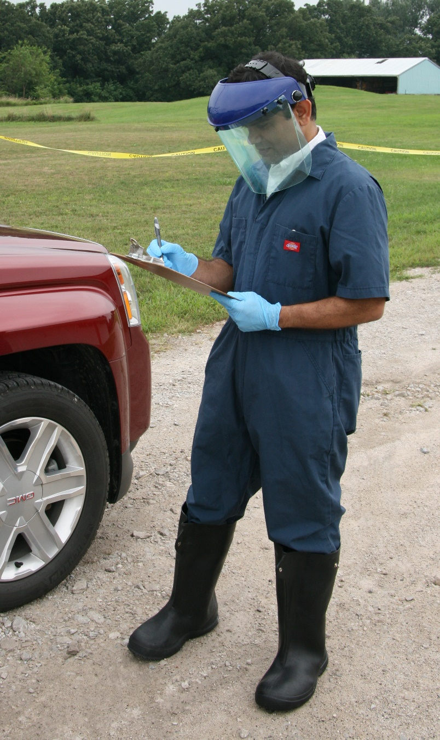
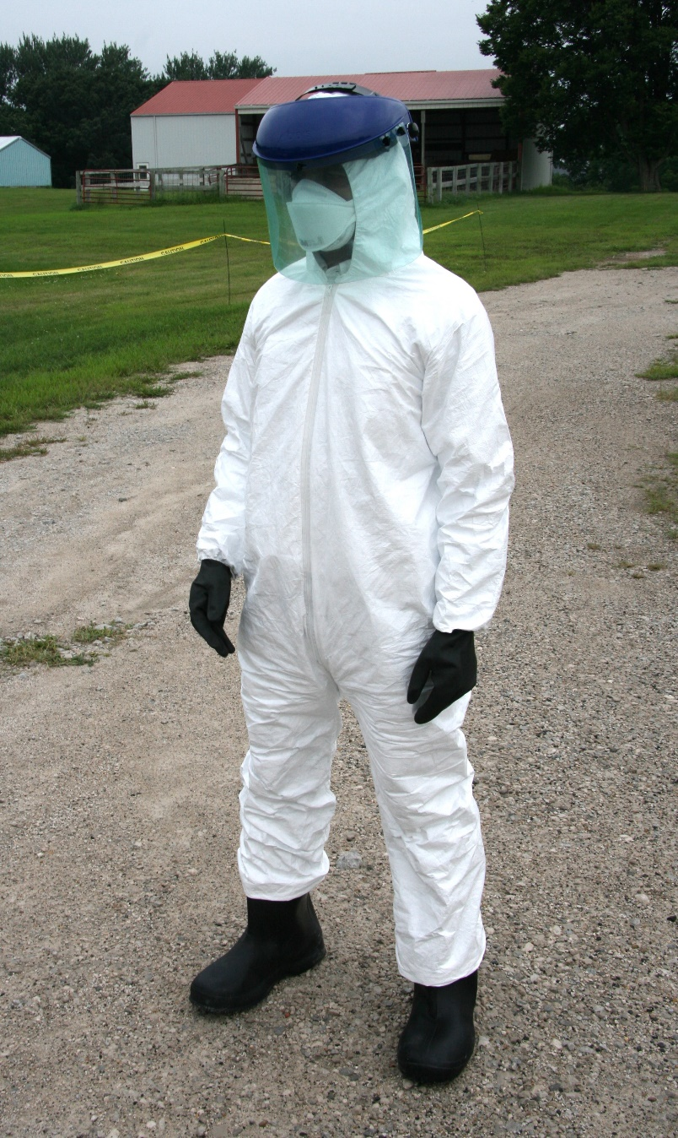
PPE for Animal Disease Emergencies
Level D
Level C
Notes:
Animal health emergency response activities will generally involve Level C or D of PPE, depending on the disease and response activity.
Photos from Andrew Kingsbury/CFSPH

Slide 4
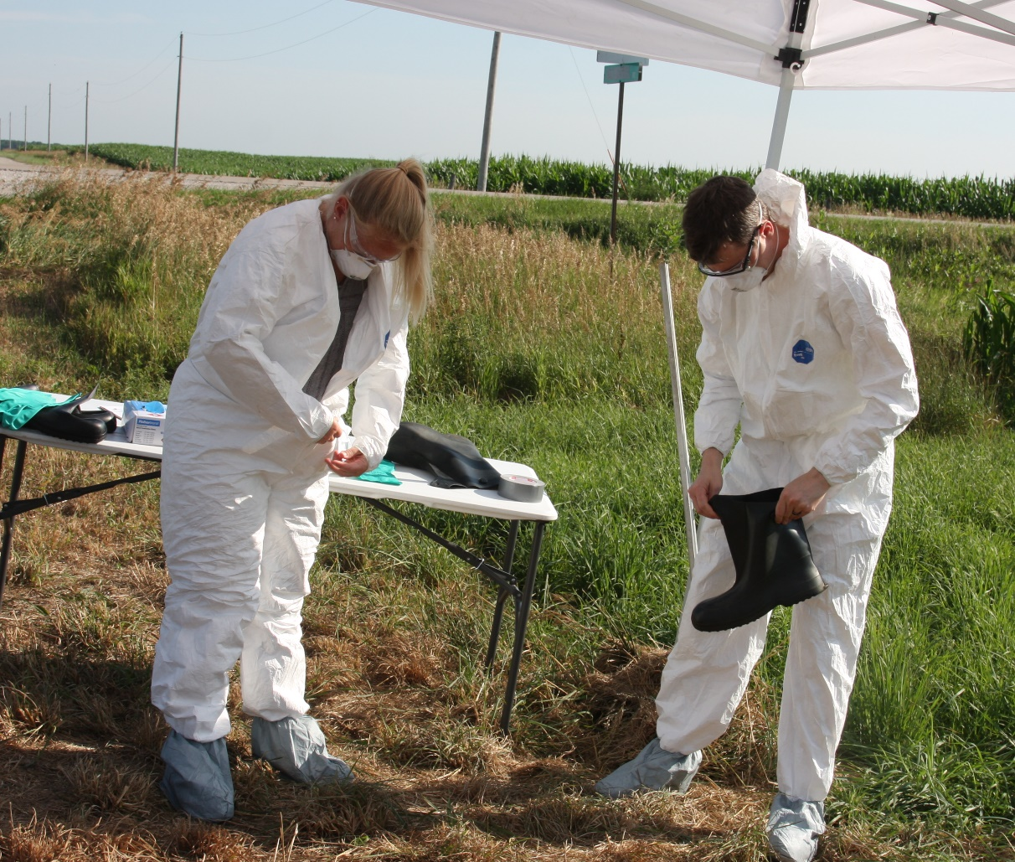
Donning Location
Immediately Outside Vehicle
Designated Cold Zone of Response Site
Notes:
Depending on the response situation, donning of PPE may occur in one of two places:
Immediately outside your vehicle, if arriving at the site alone, or
In the designated Cold Zone during larger response events.
Photos from Jane Galyon and Andrew Kingsbury/CFSPH

Slide 5
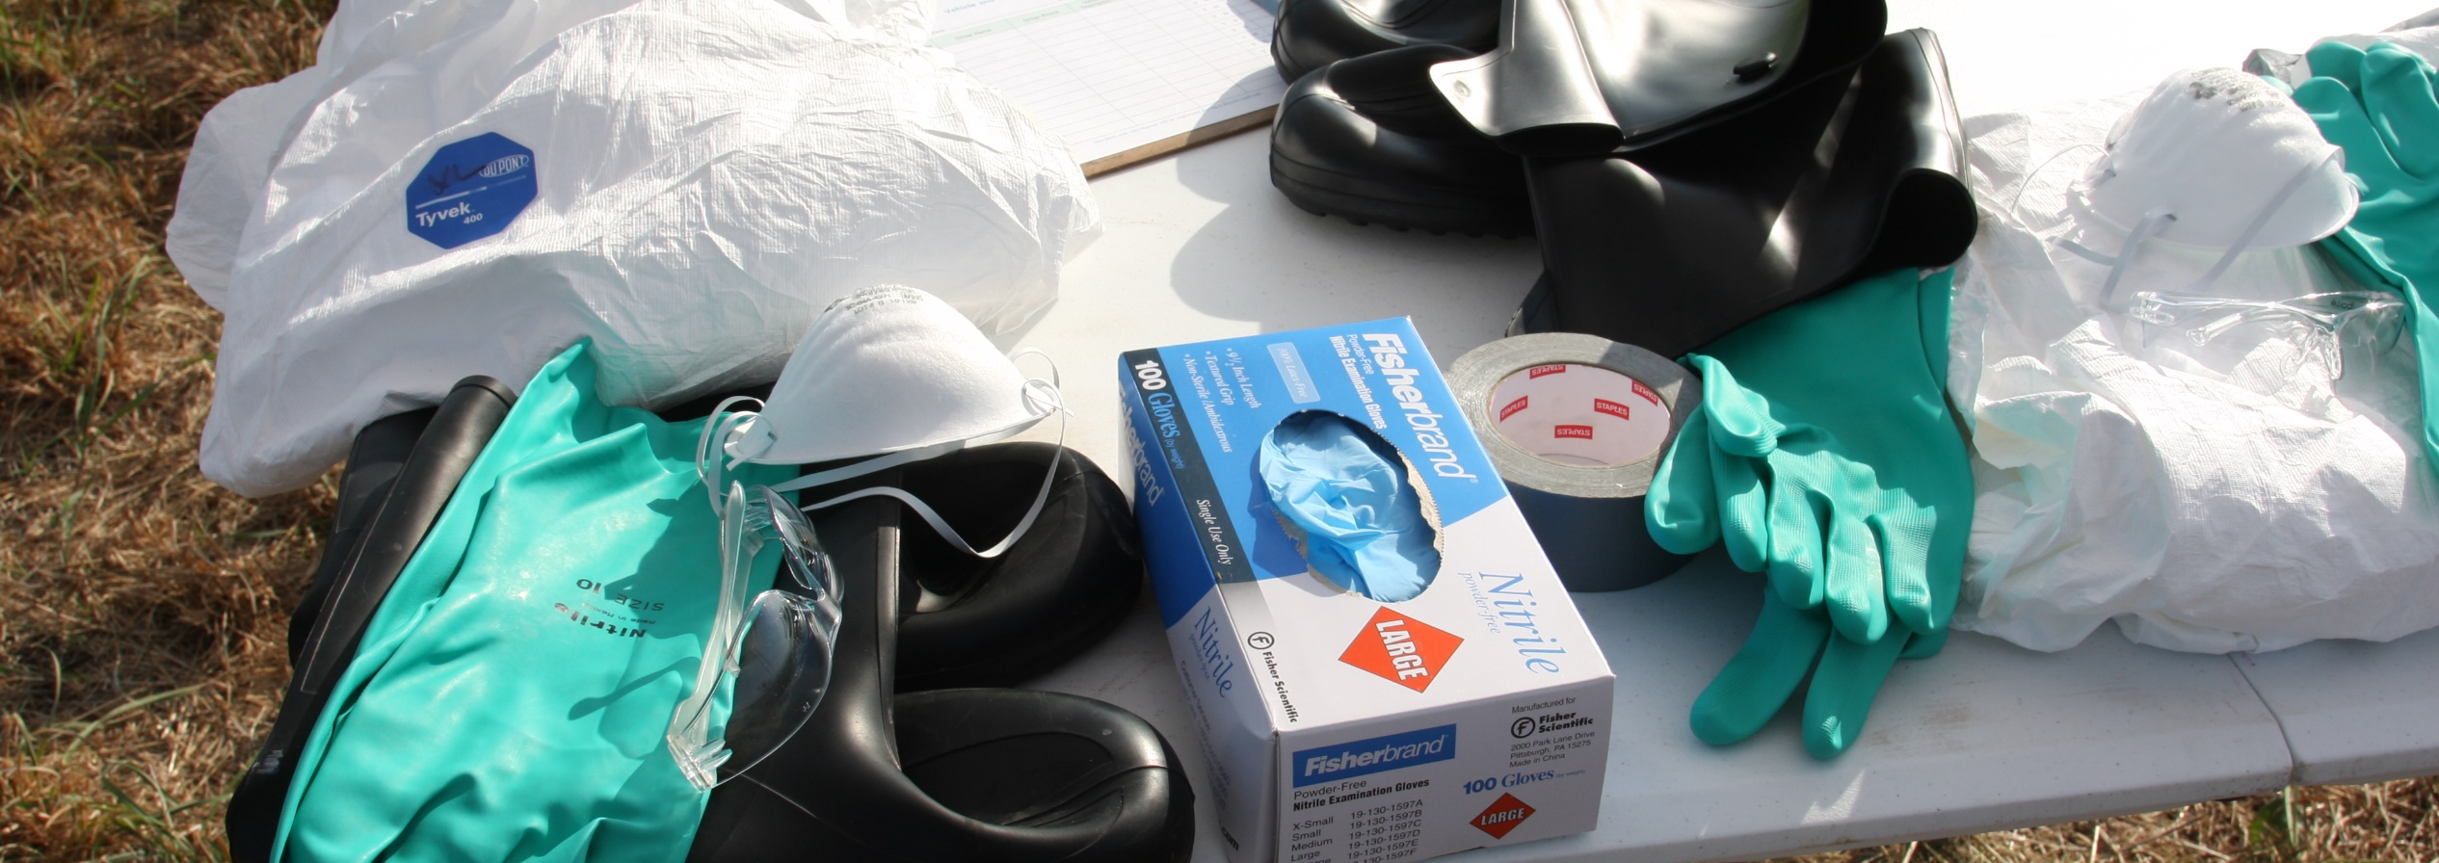
Gather Equipment
Coveralls
Respirator
Footwear
Eye protection: goggles, face
Two pairs of disposable gloves
Cut-resistant gloves
Chemical-resistant tape
Blunt-nosed scissors
Notes:
Before donning Level C PPE, gather all PPE items and any supplies that will be needed.
Tear-resistant (e.g., Tyvek®) or chemical-resistant coveralls (e.g., Tychem®) with foot pouches and a hood
An N-95 or reusable air-purifying respirator
Rubber boots, preferably steel-toed, and plastic boot covers
Goggles, a face shield if needed
Two pairs of disposable gloves, one of which should be chemical resistant
Cut-resistant gloves if performing necropsy
Chemical-resistant tape
Blunt-nosed scissors
Photo from Andrew Kingsbury/CFSPH

Slide 6
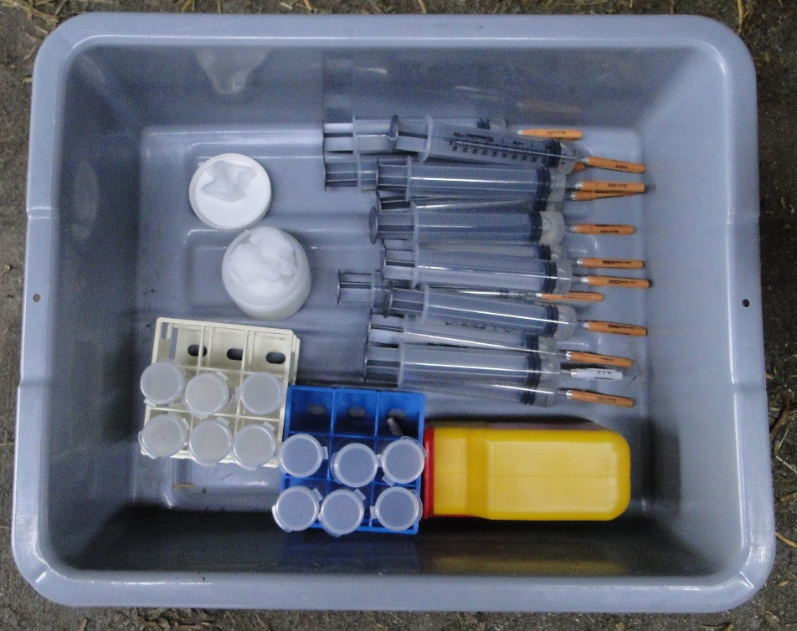
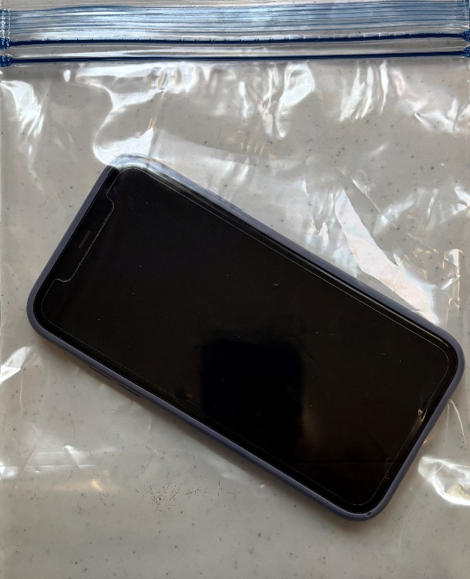
Don’t Forget
Any items needed to perform tasks onsite
Communication device in a waterproof bag
Additional items for weather conditions
Notes:
Don’t forget:
Any items needed to perform tasks onsite, such as blood or sample collection supplies, necropsy tools, biohazard bags, and a permanent marker.
If a communication device is necessary, it should be placed in a waterproof bag to allow for disinfection upon exit.
Depending on weather conditions, a cooling vest or insulating clothing may be needed.
Photos from Danelle Bickett-Weddle and Glenda Dvorak/CFSPH

Slide 7
Before Donning PPE
Inspect all PPE items – Do not use if damaged
Measure and cut pieces of tape
Notes:
Before donning PPE,
Inspect all PPE items for damage – rips, tears, defects or imperfections. Do not use items if they are defective.
Measure and cut several pieces of chemical-resistant tape. Pieces should be long enough to wrap around the top of boots, around wrists, around the hood opening, and cover the entire coverall zipper.
Cut extra pieces of tape in case one gets stuck to itself and becomes unusable during the donning process.

Slide 8
Fold Tabs on the Ends of the Tape
Notes:
Fold a small section at one end of each tape piece to form a tab for easier removal upon exiting.
Photos from Jane Galyon/CFSPH

Slide 9
Donning PPE: From Bottom to Top
Notes:
When donning PPE, keep in mind “from bottom to top”.
NOTE TO PRESENTER: THE STEPS ON THE NEXT SLIDES ARE INTENTIONALLY PLACED SO THE FIRST BULLET IS ON THE BOTTOM AND SUBSEQUENT BULLETS BUILD UPWARD. THIS IS TO CONVEY THE BOTTOM UP THEME THROUGHOUT.

Slide 10
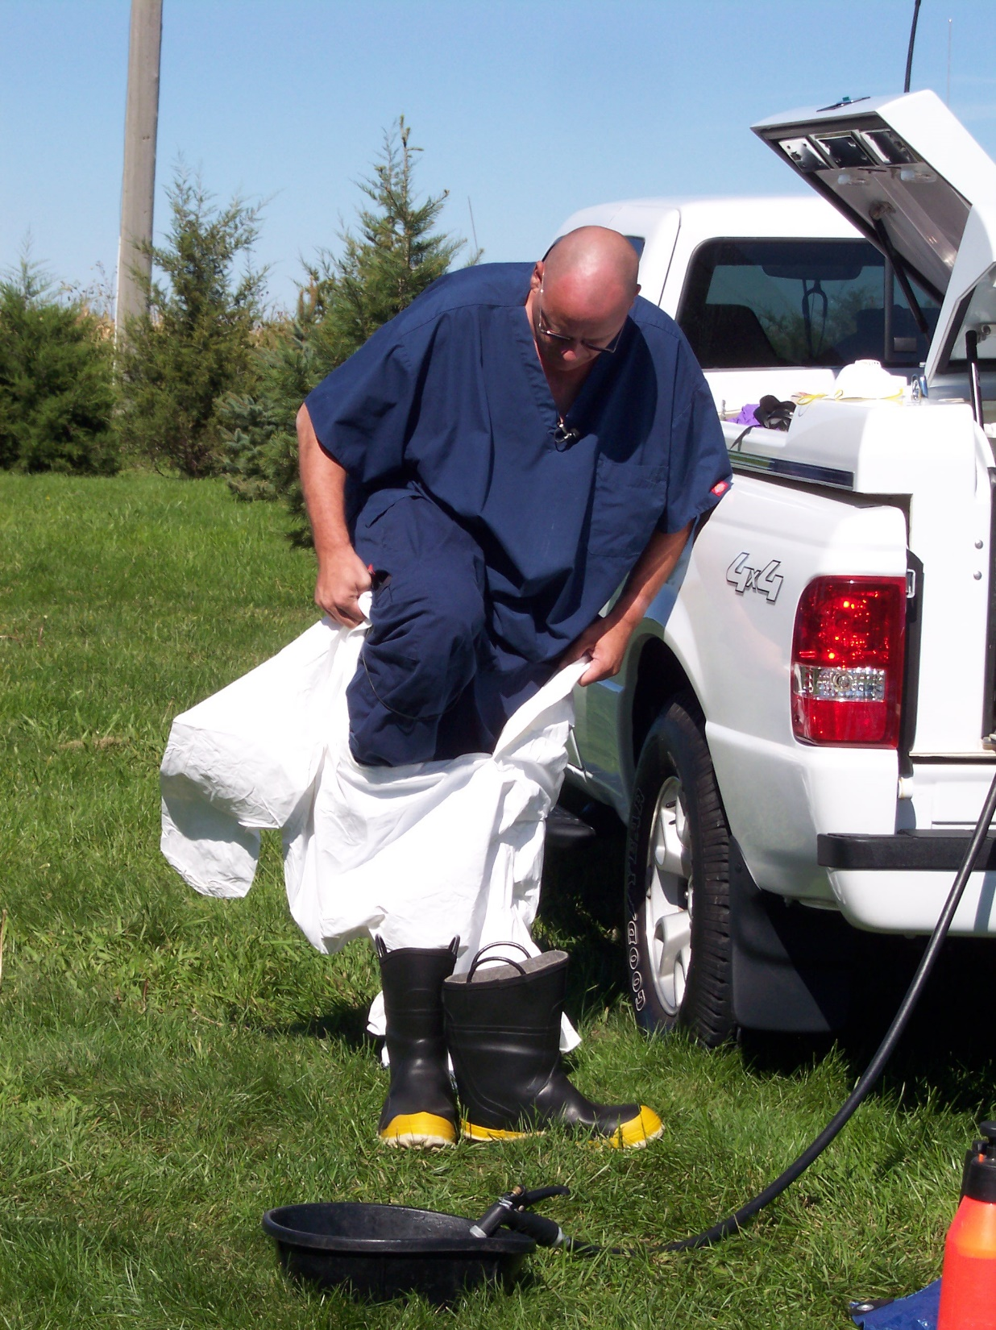
Donning PPE: Put On Suit
Insert socked feet into the foot pouches of the protective coveralls
Notes:
Begin by putting on the suit.
Remove your street shoes and insert socked feet into the foot pouches of the protective coveralls.
Photo from Jane Galyon/CFSPH

Slide 11
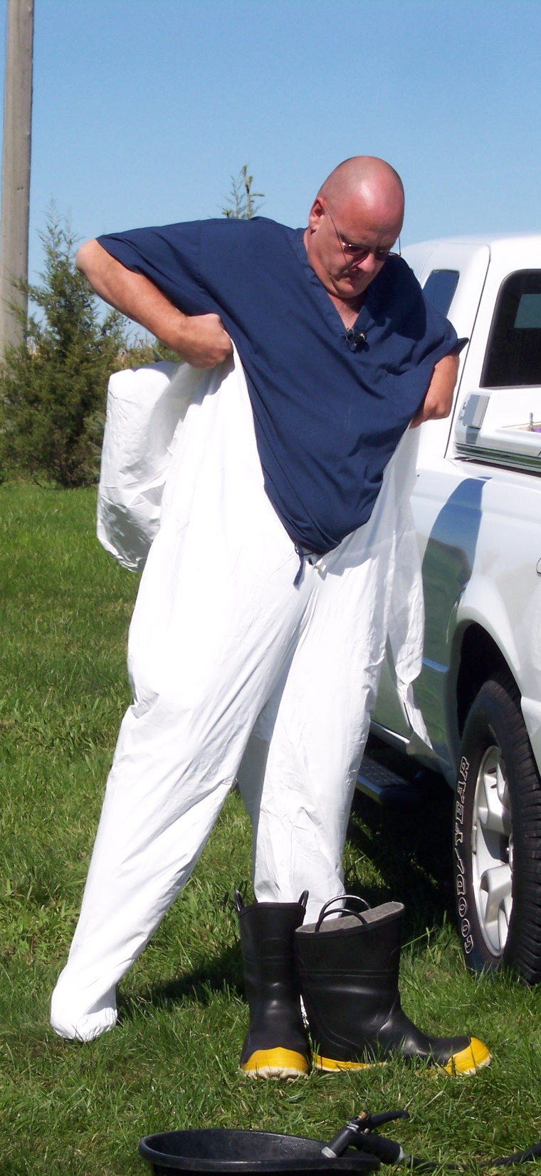
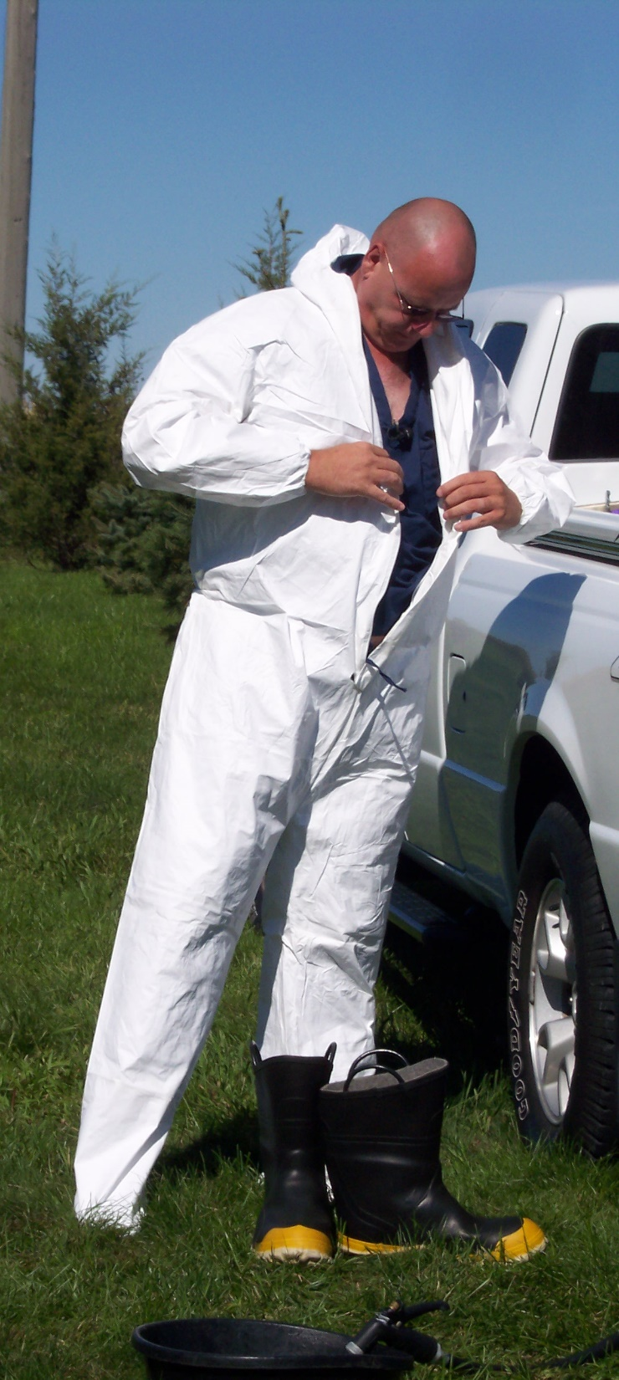
Donning PPE: Pull Up Suit
DO NOT put on the hood yet
Zip suit part way up
Pull suit over shoulders
Pull protective suit up and insert arm into sleeves
Notes:
Pull the protective suit up, insert arms into the sleeves, and pull the suit over your shoulders.
Zip the suit part way up.
DO NOT put on the hood yet.
Photos from Jane Galyon/CFSPH

Slide 12
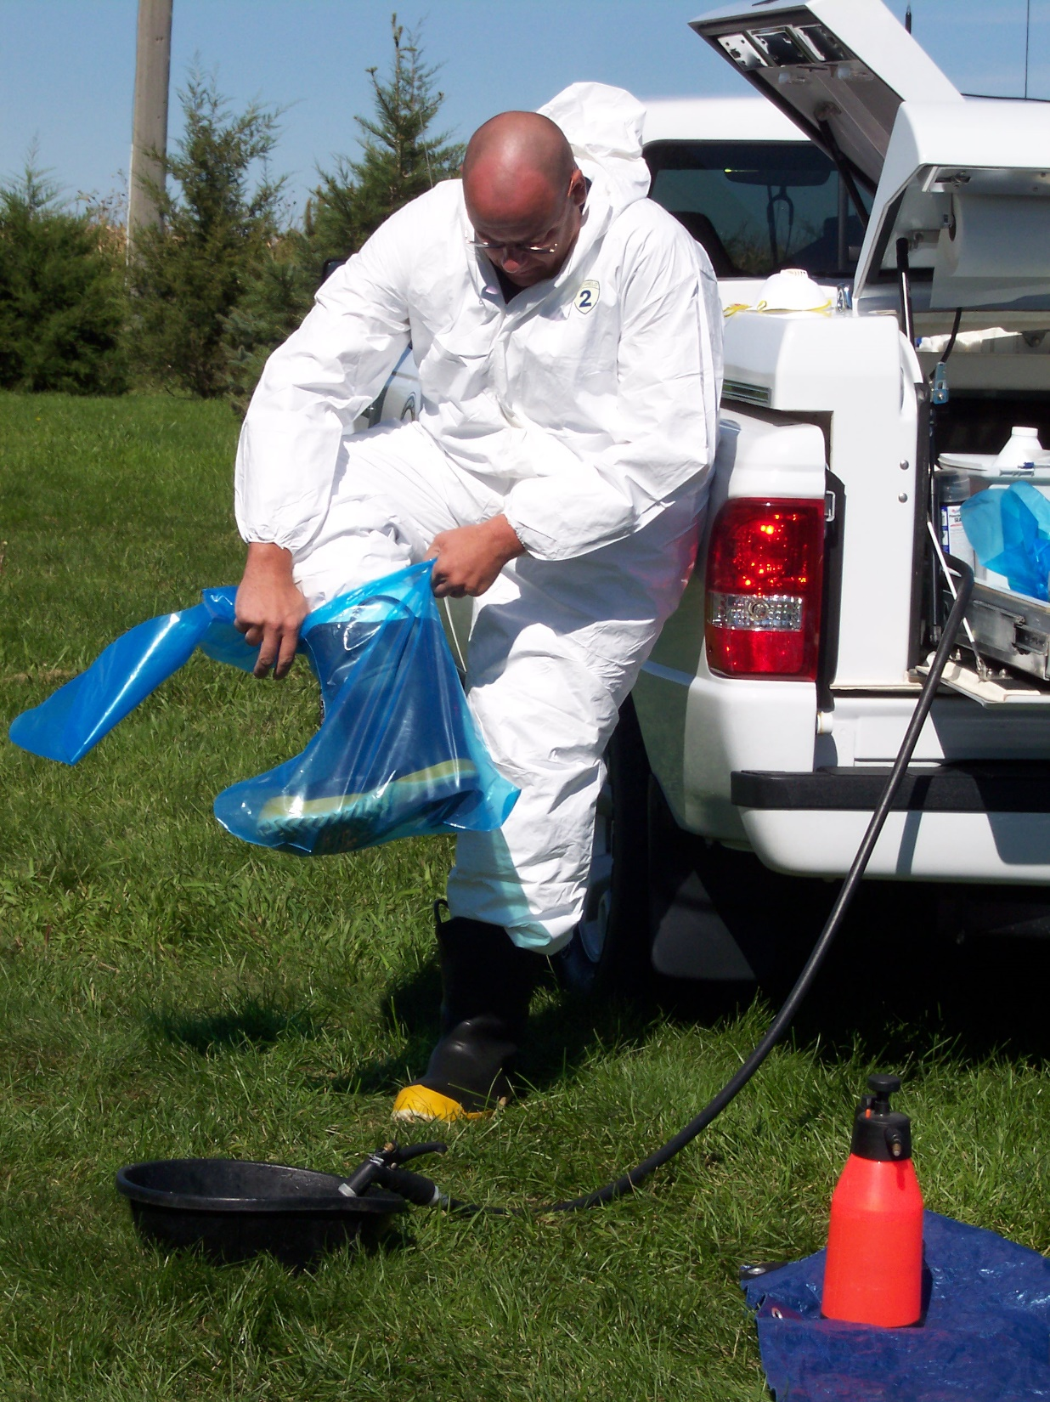
Donning PPE: Put On Footwear
Use caution to avoid tripping or falling
Put on disposable boot covers
Step into boots
Notes:
Step into water-resistant or chemical-resistant boots. Use caution so you do not trip or fall during this step.
Put on disposable boot covers, if required.
Photo from Jane Galyon/CFSPH

Slide 13
Donning PPE: Tape Junction
Place the tape tab in an accessible location for easy removal
Wrap chemical-resistant tape around the top of the boot, attaching it to the protective suit
Notes:
Using the buddy system, wrap a chemical-resistant tape strip around the top of the boot, attaching it to the protective suit. This helps to ensure no fluid enters the boot from outside.
Be sure to allow room for bending and movement, to avoid rips during tasks.
Place the tape tab created in an accessible location for easy removal.
Photo from Jane Galyon/CFSPH

Slide 14
Donning PPE: First Glove Layer
Pull on the first pair of gloves
Notes:
Pull on the first pair of gloves; these may be latex or nitrile and serve as an inner layer of protection for the hands.
Photo from Andrew Kingsbury/CFSPH

Slide 15
Donning PPE: Respiratory Protection
Perform required seal check
Put on the assigned N-95 or air-purifying respirator
Notes:
Put on the assigned N-95 or air-purifying respirator.
Perform the required seal check.
Photo from Andrew Kingsbury/CFSPH

Slide 16
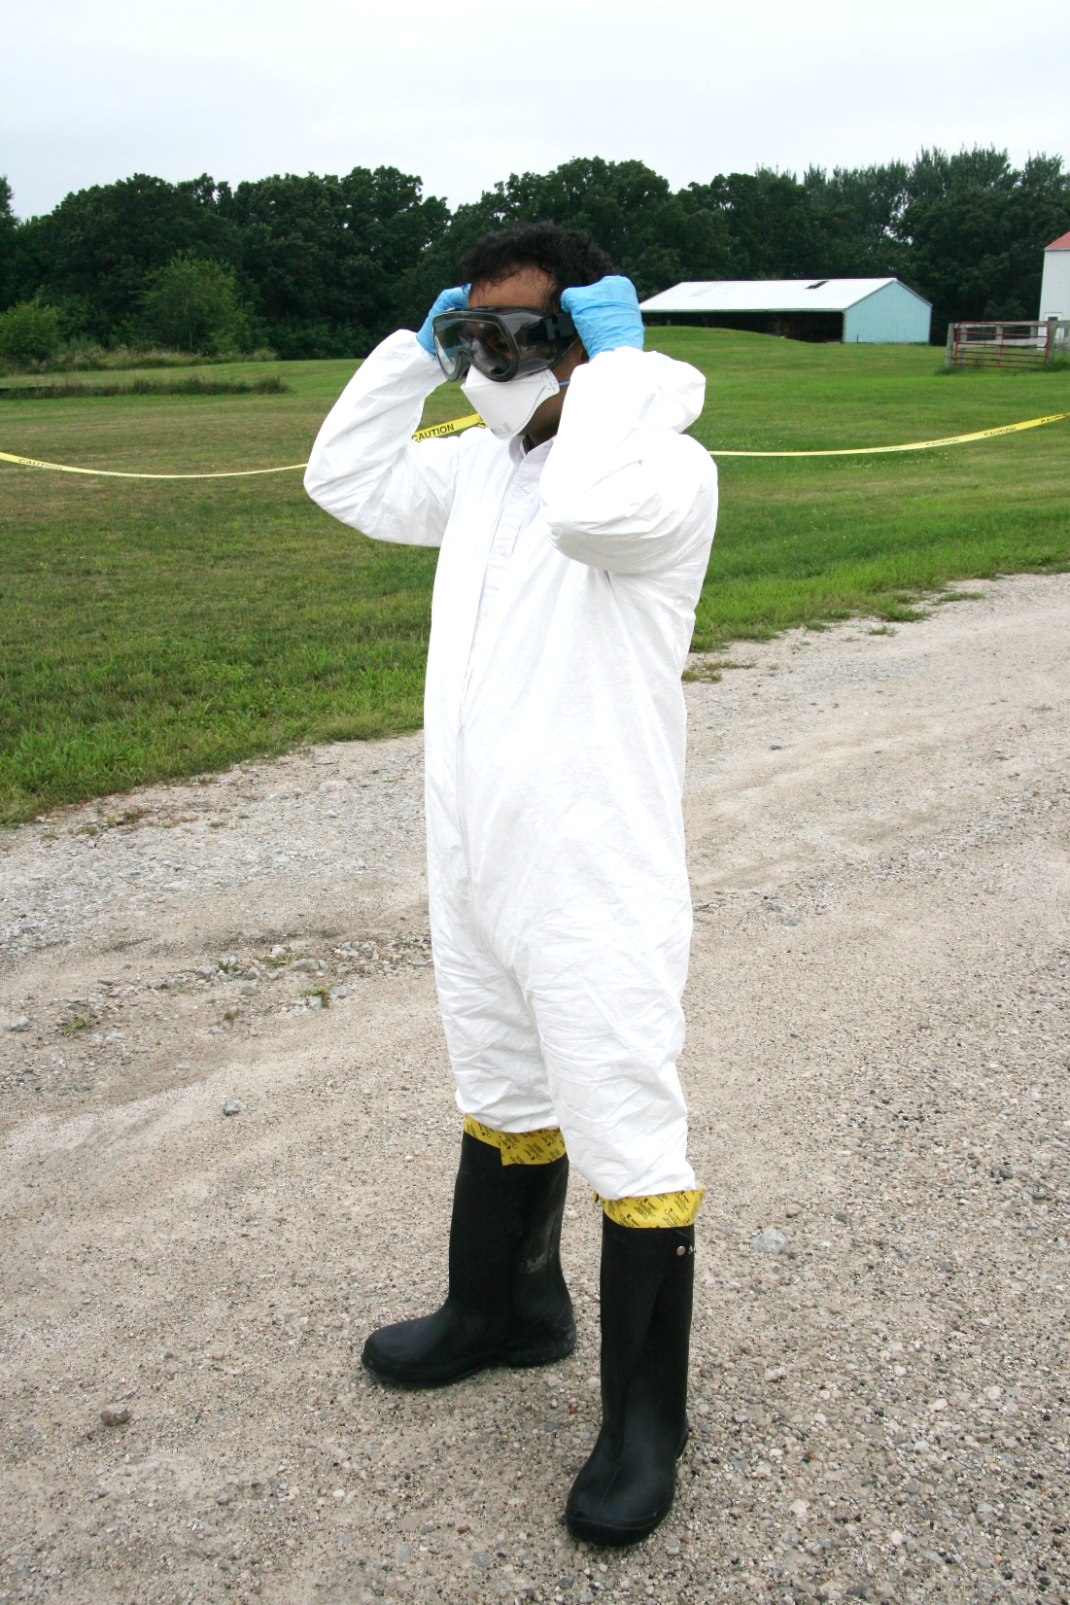
Donning PPE: Eye/Face Protection
Do not disrupt the respirator seal
Put on goggles, and a face shield, if necessary
Notes:
If eye protection is not part of the respirator, put on goggles, and a face shield if necessary. Do not disrupt the respirator seal.
Photo from Andrew Kingsbury/CFSPH

Slide 17
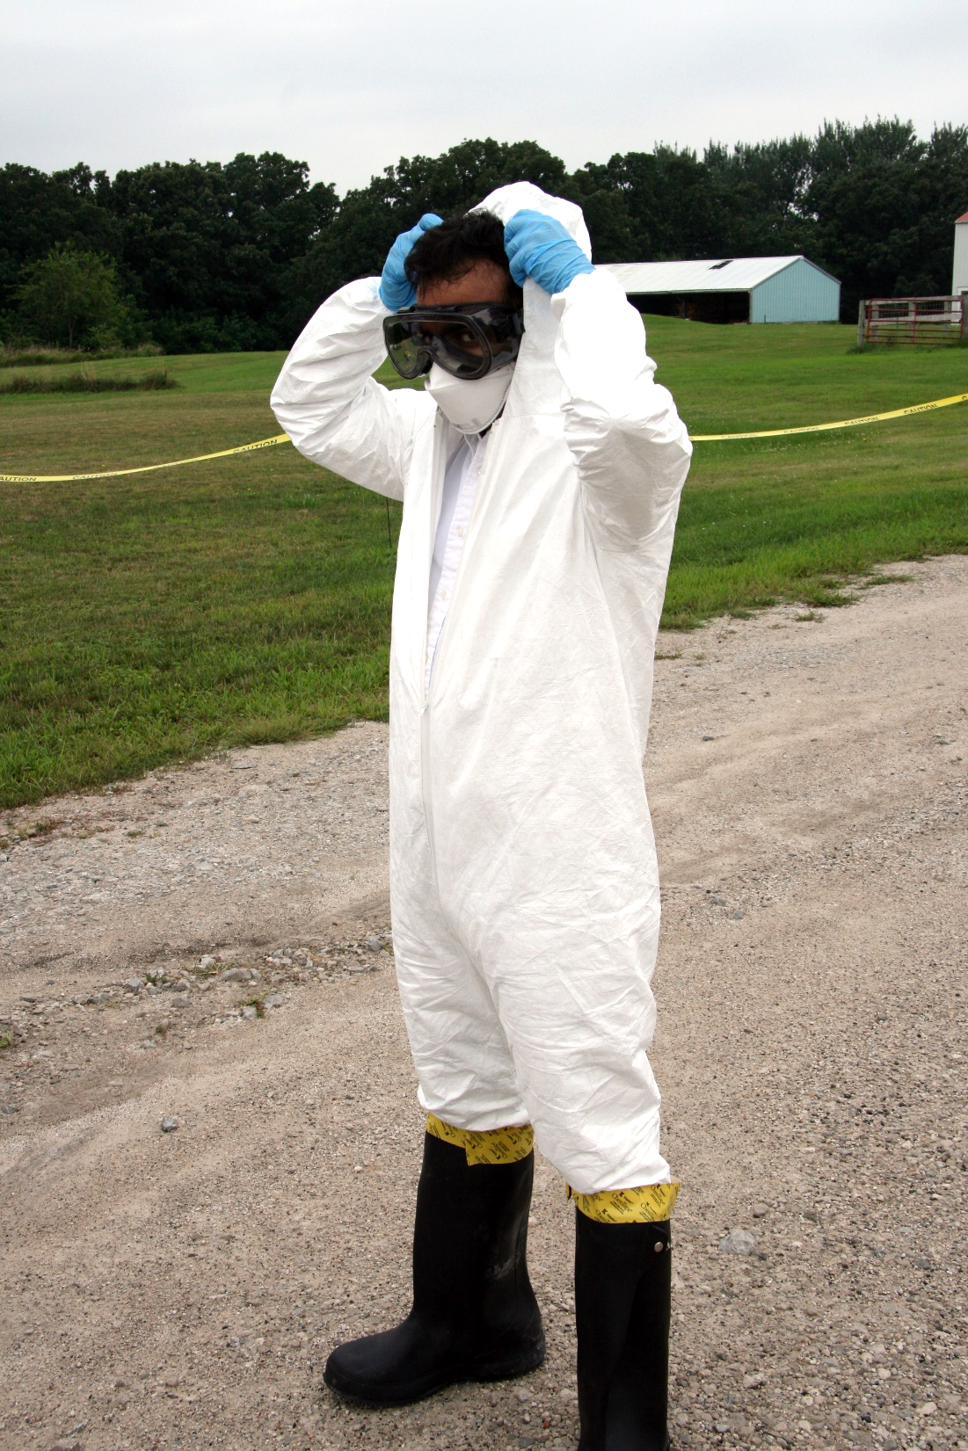
Donning PPE: Cover Head
Zip up coveralls completely
Do not disrupt the respirator seal
Pull on suit hood, ensure hair and ears are covered
Notes:
Pull on the suit hood, ensuring hair and ears are covered.
Do not disrupt the respirator seal.
Zip up the protective coveralls completely.
Photo from Andrew Kingsbury/CFSPH

Slide 18
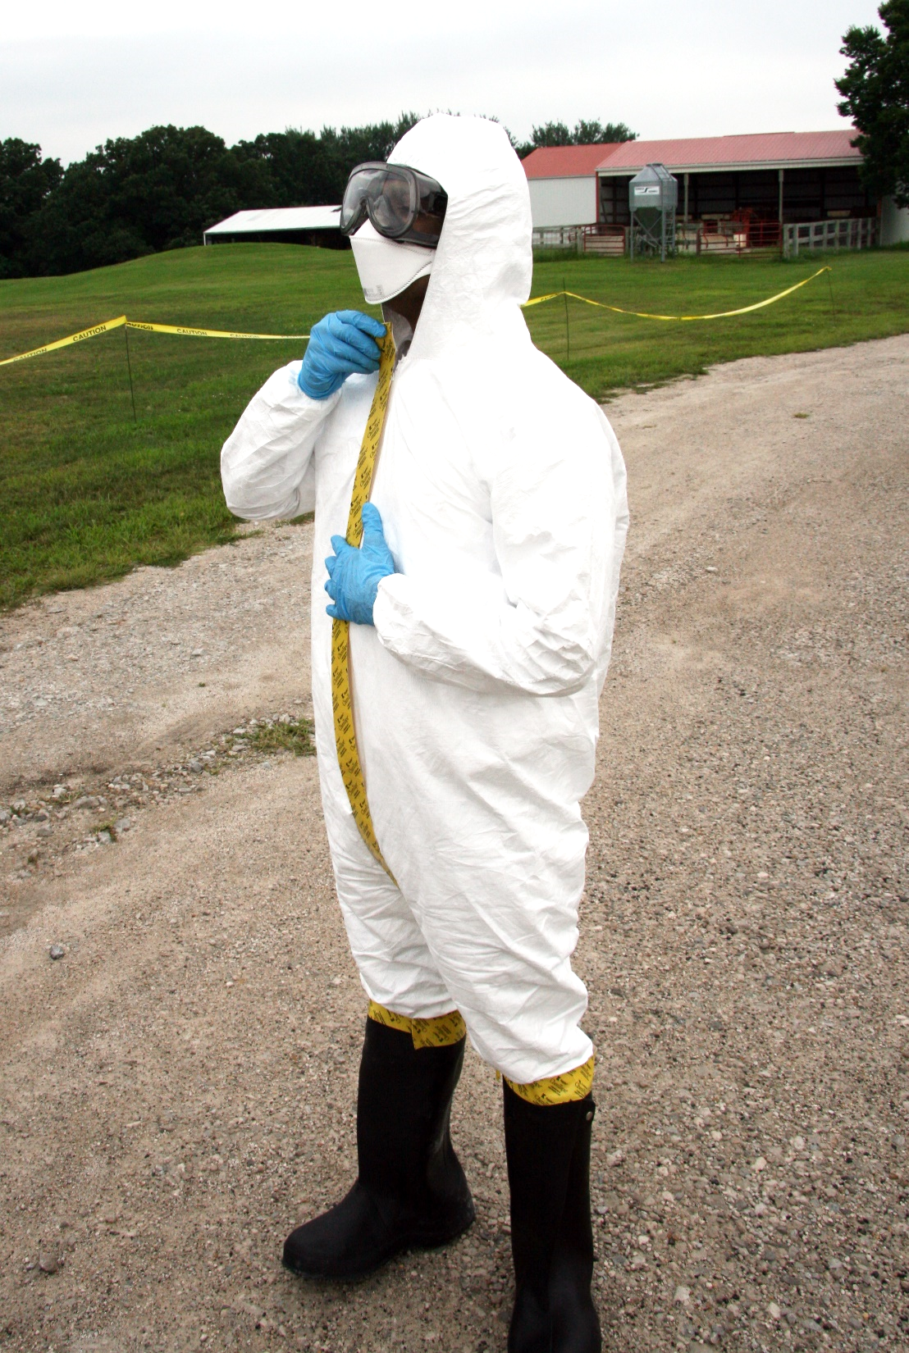
Donning PPE: Tape All Junctions
Leave a tape tab to help with removal
Seal the length of the suit zipper with chemical-resistant tape
Notes:
Seal the length of the zipper with chemical-resistant tape.
Leave a tab on the tape at the top to help with removal.
Photo from Andrew Kingsbury/CFSPH

Slide 19
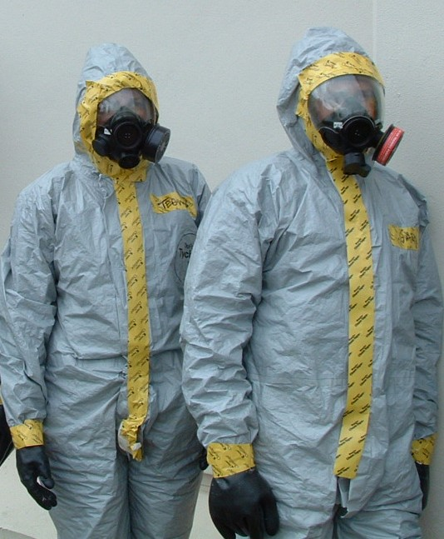
Donning PPE: Tape The Mask
Be sure to cover the area under the chin
Tape around a full-mask facepiece to completely seal the coverall hood and respirator
Notes:
If a full-face respirator is required, place tape around the facepiece to completely seal the hood of the coveralls to the respirator.
Be sure to cover the area under the chin as well.
Photo from Tegwin Taylor/CFSPH

Slide 20
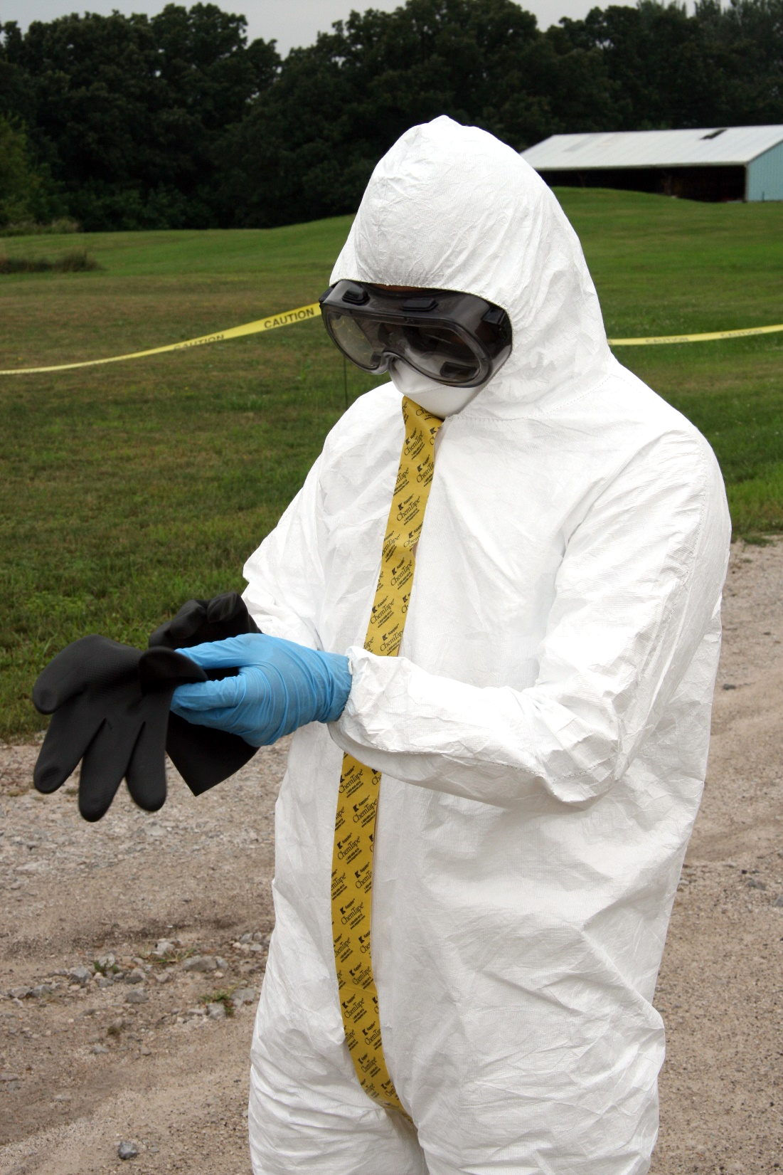
Donning PPE: Outer Gloves
Stretch arms out to ensure there is room for movement
Pull suit cuff over gloves
Put chemical-resistant gloves over inner gloves
Notes:
Put a pair of chemical-resistant gloves over the inner gloves.
Pull the cuffs of the protective coveralls over the gloves.
Stretch arms out to ensure there is room for movement.
Photo from Andrew Kingsbury/CFSPH

Slide 21
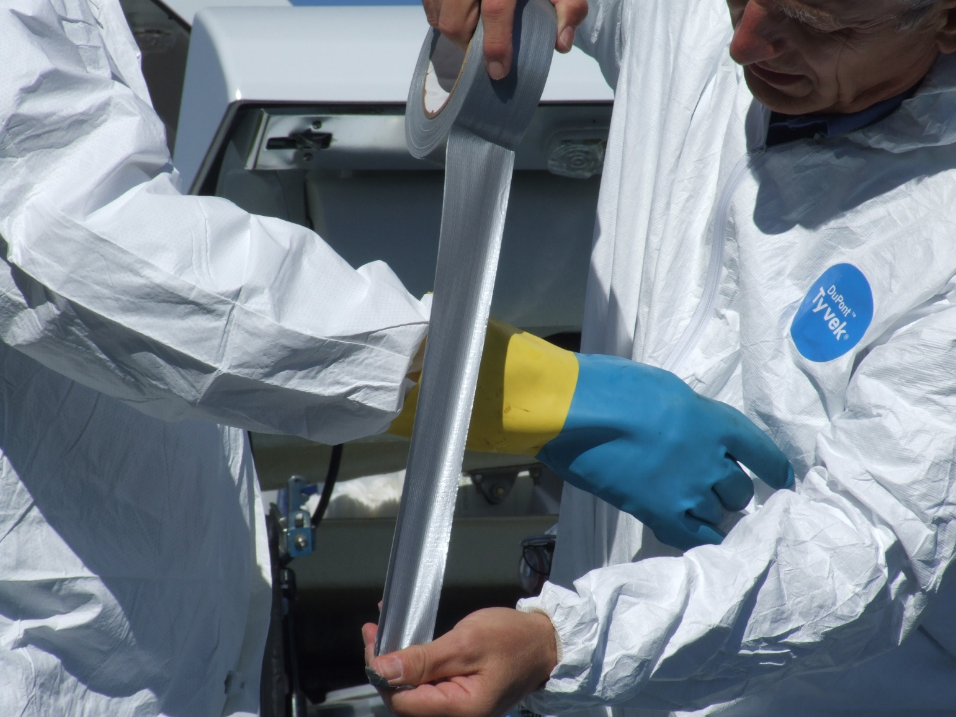
Donning PPE: Tape Junction at the Wrist
Wrap tape around each wrist at the junction of the glove and sleeve cuff
Notes:
Again, using the buddy system, wrap chemical-resistant tape around each wrist at the junction of the glove and sleeve cuff.
Leave enough give so arms can move freely without ripping.
Ensure the tab on the tape is accessible to aid in removal.
Photo from Andrew Kingsbury/CFSPH

Slide 22
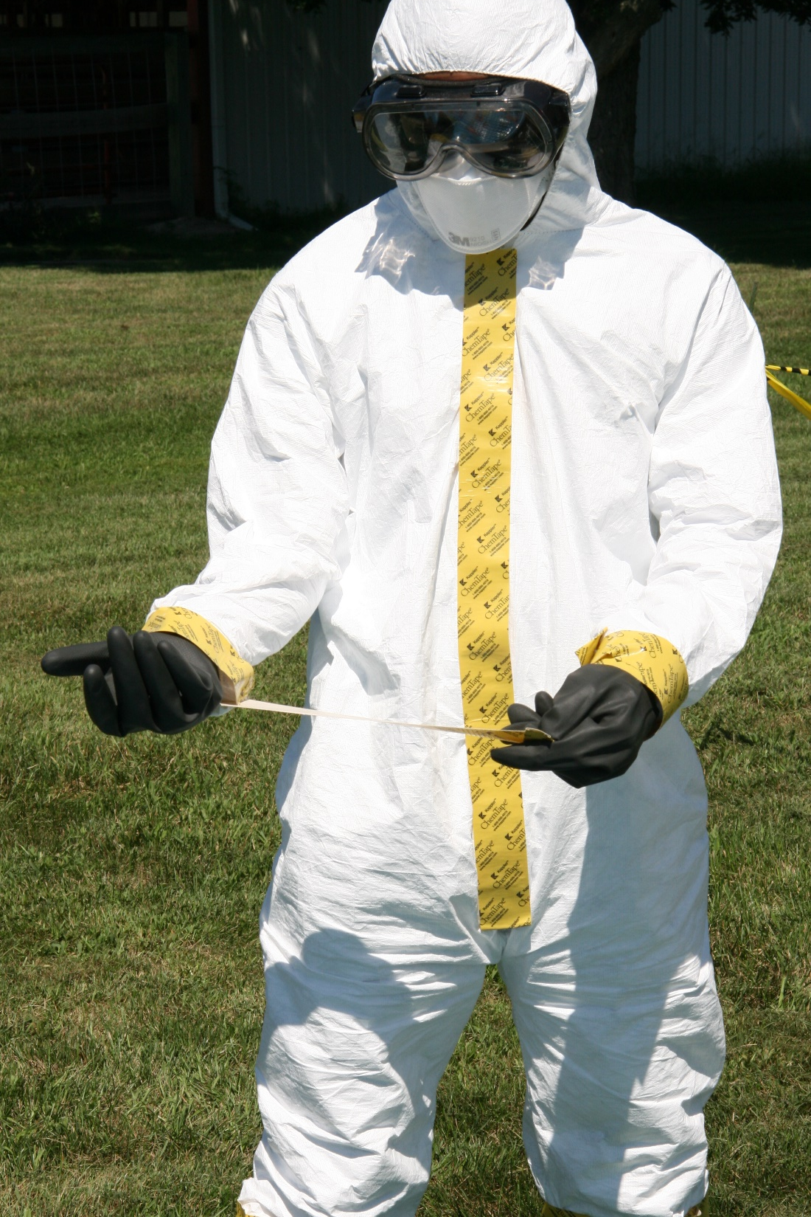
Donning PPE: Check All Seals
Double-check the tape seal for all junctions
Notes:
Double-check to ensure all junctions have a tape seal.
Photo from Andrew Kingsbury/CFSPH

Slide 23
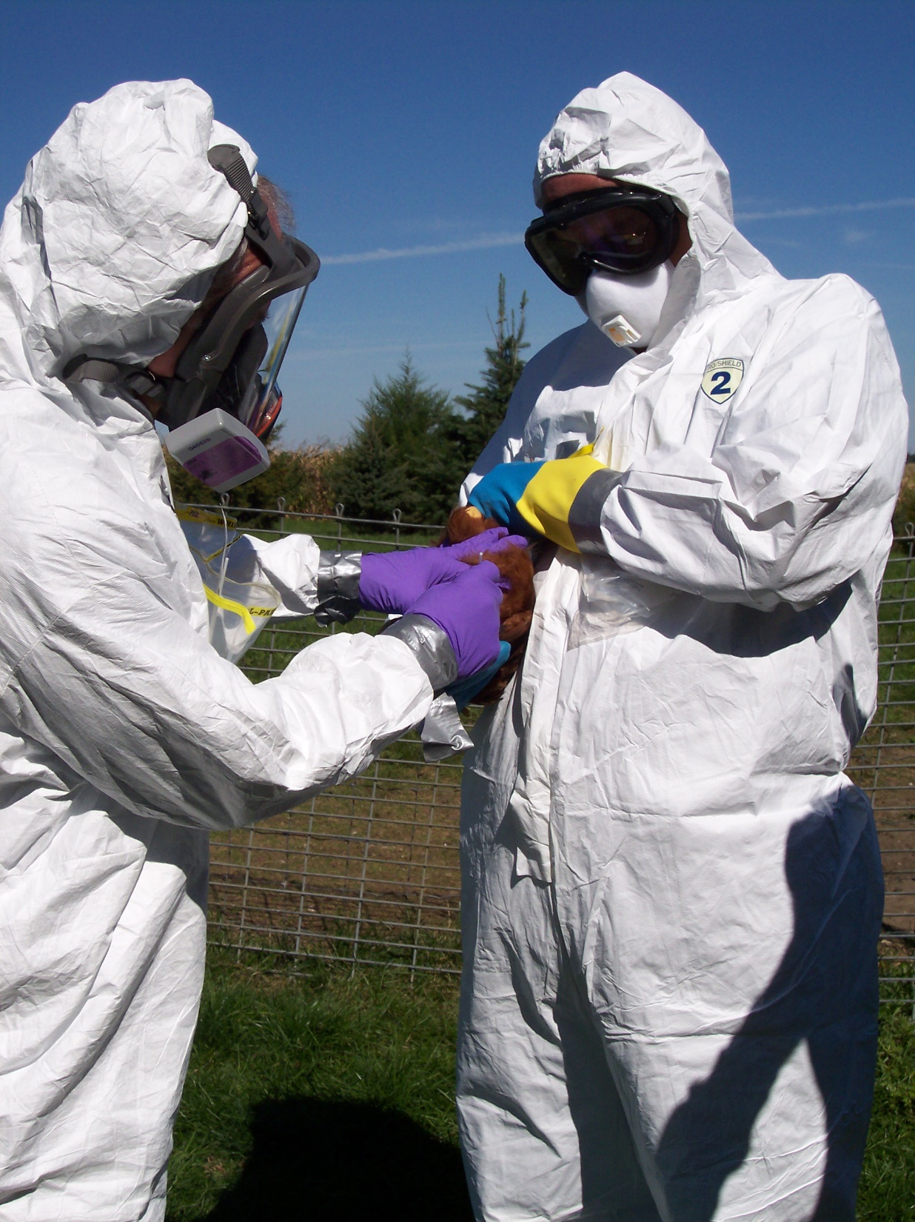
Donning PPE: Final Steps
Assist your partner with donning their PPE
Gather supplies
Enter the site to perform duties
Notes:
If using the “buddy system”, assist your partner in donning their PPE.
Gather your supplies and enter the site to perform your duties.
Photo from Andrew Kingsbury/CFSPH

Slide 24
Additional PPE Videos
Notes:
For more information on PPE use during animal health emergencies, including proper donning and doffing, and safety considerations, follow this QR code to the Just in time Training website.

Slide 25
Acknowledgements
Development of this material was made possible through a grant provided to the Center for Food Security and Public Health at Iowa State University, College of Veterinary Medicine from the U.S. Department of Agriculture (USDA) Animal and Plant Health Inspection Service through the National Animal Disease Preparedness and Response Program (NADPRP)
Notes:
Development of this material was made possible through a grant provided to the Center for Food Security and Public Health at Iowa State University, College of Veterinary Medicine from the U.S. Department of Agriculture Animal and Plant Health Inspection Service through the National Animal Disease Preparedness and Response Program.

