Slide 1
Personal Protective Equipment
Safety While Wearing PPE
Notes:
The use of personal protective equipment (PPE) during an animal health emergency is critical for responder protection; however, there are several safety issues to be aware of when wearing PPE.

Slide 2
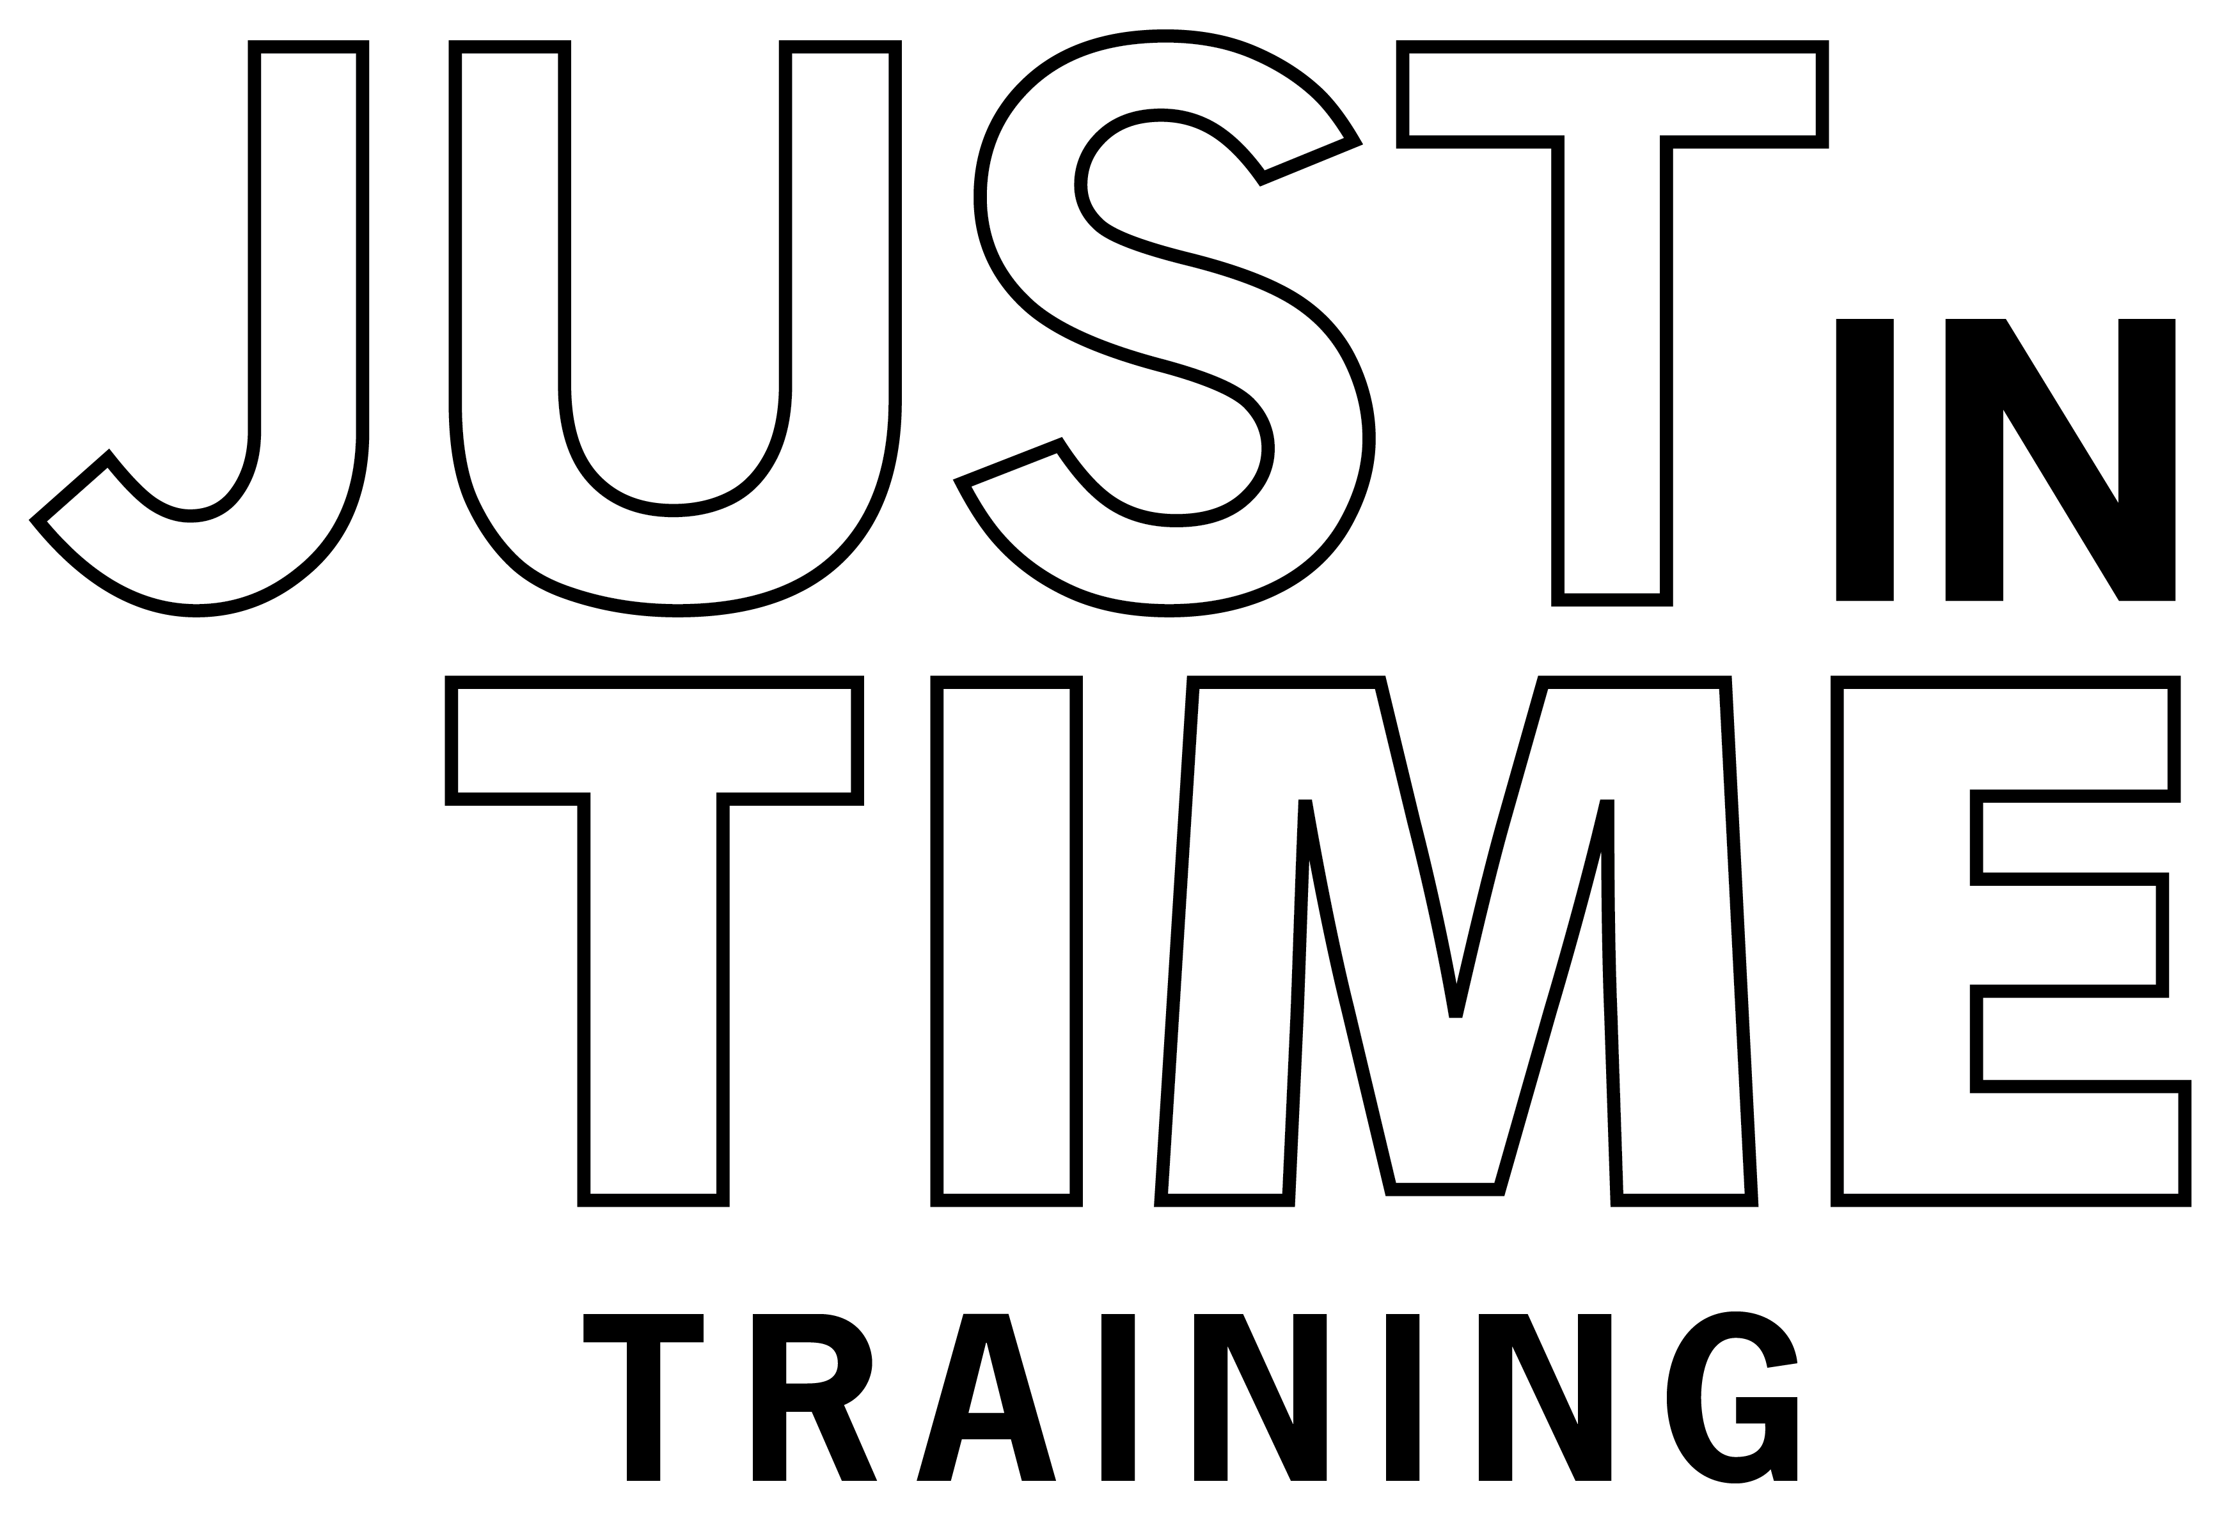
Just in Time Training
Notes:
This Just-In-Time training overviews…

Slide 3
PPE Safety
Physical
Psychological
Biological
Environmental
Notes:
several physical, psychological, environmental, and biological safety concerns, and provides precautions to take to minimize risks while wearing PPE.

Slide 4
Physical Challenges
Notes:
Several physical challenges while wearing PPE will impact your ability to perform tasks and can increase the risk of injury.

Slide 5
PPE will:
Restrict movement
Limit mobility
Add weight and bulk
Notes:
The addition of the protective layers of coveralls and boots will restrict movement, limit mobility, and add weight and bulk. This will increase the energy needed for even the simplest tasks and can lead to rapid fatigue.
Photo from Gordon Harman/CDP

Slide 6
Reduce Dexterity
Less ability to grip or handle items
Notes:
Gloves will reduce dexterity and the ability to grip objects. This can make the handling of items or equipment difficult and potentially dangerous if dropped.
Photo from Jane Galyon/CFSPH

Slide 7
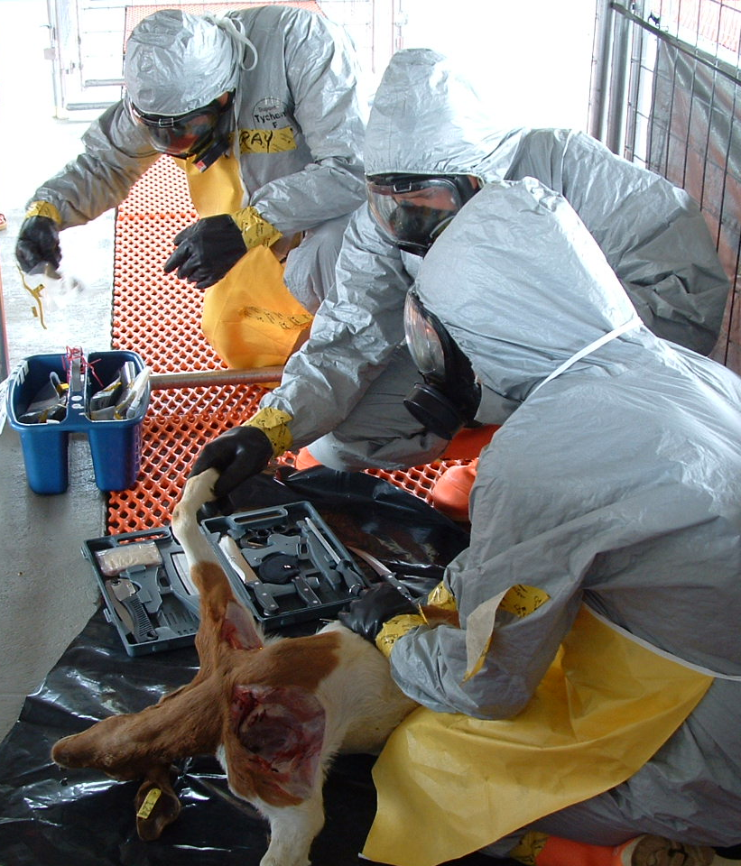
Limit Senses
Hearing
Vision
Communication
Notes:
Hoods will limit your ability to hear. Goggles or masks will reduce your line of vision and can become easily fogged or scratched, further decreasing visibility. Wearing masks or respirators makes communication with other responders difficult.
Photo from Tegwin Taylor/CFSPH

Slide 8
Skin Allergies
Notes:
Some PPE items, such as those made of latex, may cause an allergic reaction.
Photo licensed from Adobe Stock

Slide 9
Precautions
Be Aware of Physical Limitations
Use the Buddy System
Take your time performing tasks
Recognize when you are fatigued
Take appropriate action
Remain in close visual contact
Assist each other
Watch for signs of distress or injury
Notes:
Take your time performing tasks. Know your limitations; do not overexert yourself. Recognize when you are fatigued and take appropriate actions.
Use the Buddy System. Remain in close visual contact. Assist as requested or needed. Observe each other for signs of distress or injury

Slide 10
Psychological and Mental Stress
Notes:
Animal disease response situations and some tasks can be mentally stressful.

Slide 11
Range of Symptoms
Physical, cognitive, emotional
Claustrophobia
Can affect your ability to function
Notes:
This can manifest into a range of physical, cognitive, and emotional symptoms during and after a response. It can also affect your ability to function and may contribute to safety issues while wearing PPE. Additionally, the confining nature of PPE can cause feelings of claustrophobia and psychological stress.
Photo licensed from Adobe Stock

Slide 12
Precautions for Mental Stress
Learn stress-management techniques
Recognize symptoms of emotional stress
Appropriate self-care
Seek assistance, support when needed
Notes:
To minimize mental and psychological impacts, learn stress-management techniques to help you stay calm and focused under high-risk and/or emergency conditions. Be able to recognize the symptoms of emotional stress. Closely monitor yourself and fellow responders for any of these signs. Always take appropriate self-care and seek assistance and support when needed.

Slide 13
Biological Risks
Notes:
Some animal diseases have the potential to cause human infection and illness.

Slide 14
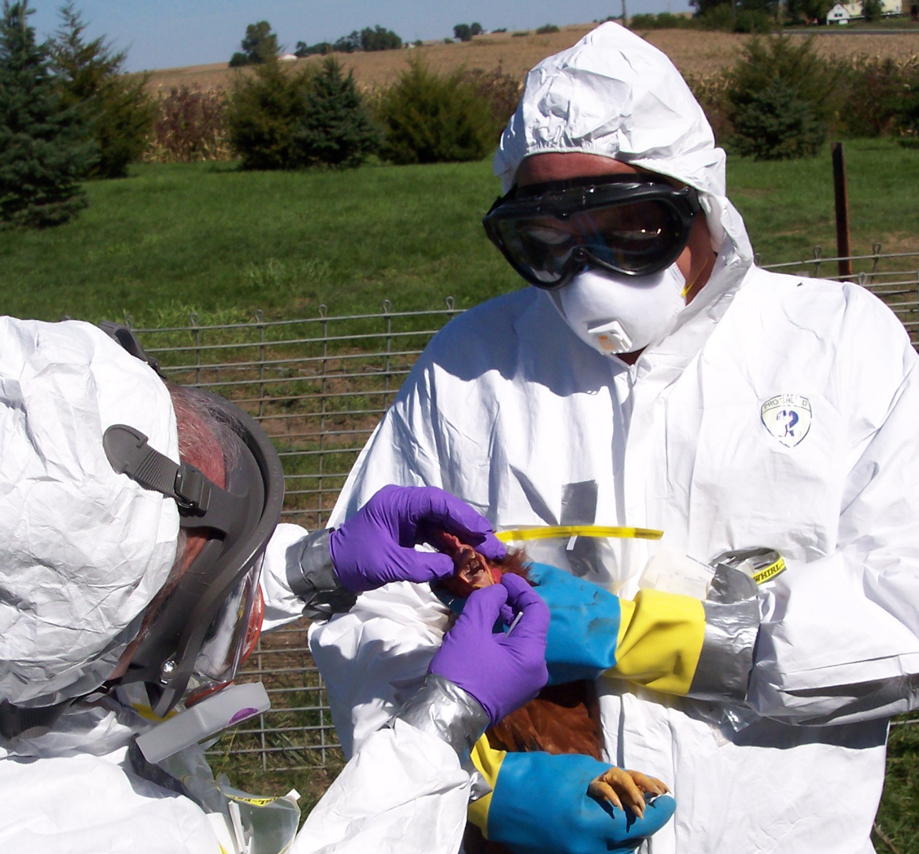
Zoonoses
Diseases of animals that can affect people
Notes:
Zoonotic diseases, also called zoonoses, include diseases that can be transmitted between animals and people. Exposures may occur through the skin, eyes, mouth, or respiratory tract. One example of a zoonotic disease is avian influenza.
Photo from Jane Galyon/CDP

Slide 15
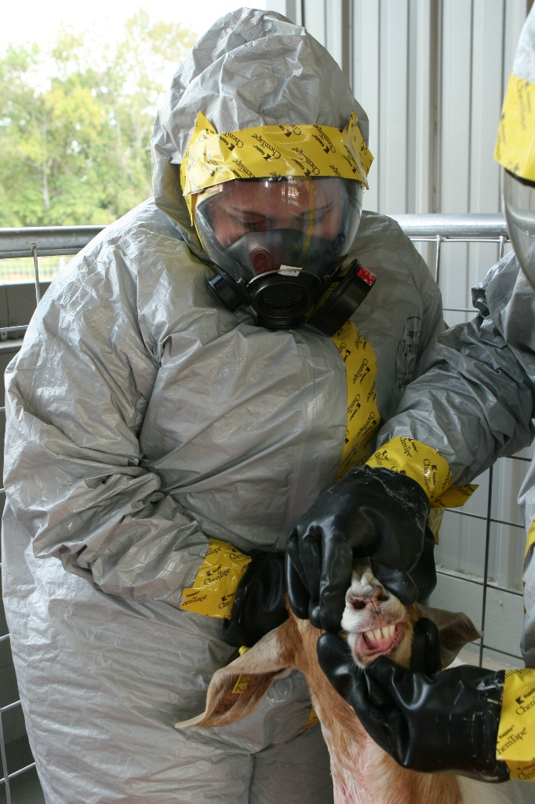
Precautions for Biological Risks
PPE
Wash/Sanitize Hands
Buddy System
Notes:
To protect yourself from zoonotic diseases, wear PPE properly to reduce exposure. Continually monitor your PPE for any rips or breakdown of materials. If this occurs, replace compromised equipment.
Use the Buddy System and stay in close visual contact with your partner. Periodically check the integrity of their PPE.
Always wash and sanitize your hands after removing PPE.
Photos from Tegwin Taylor and Jane Galyon/CFSPH

Slide 16
Hazards from the Environment
Notes:
Depending on the location or time of year, environmental conditions can impact responder health and safety while wearing PPE.

Slide 17
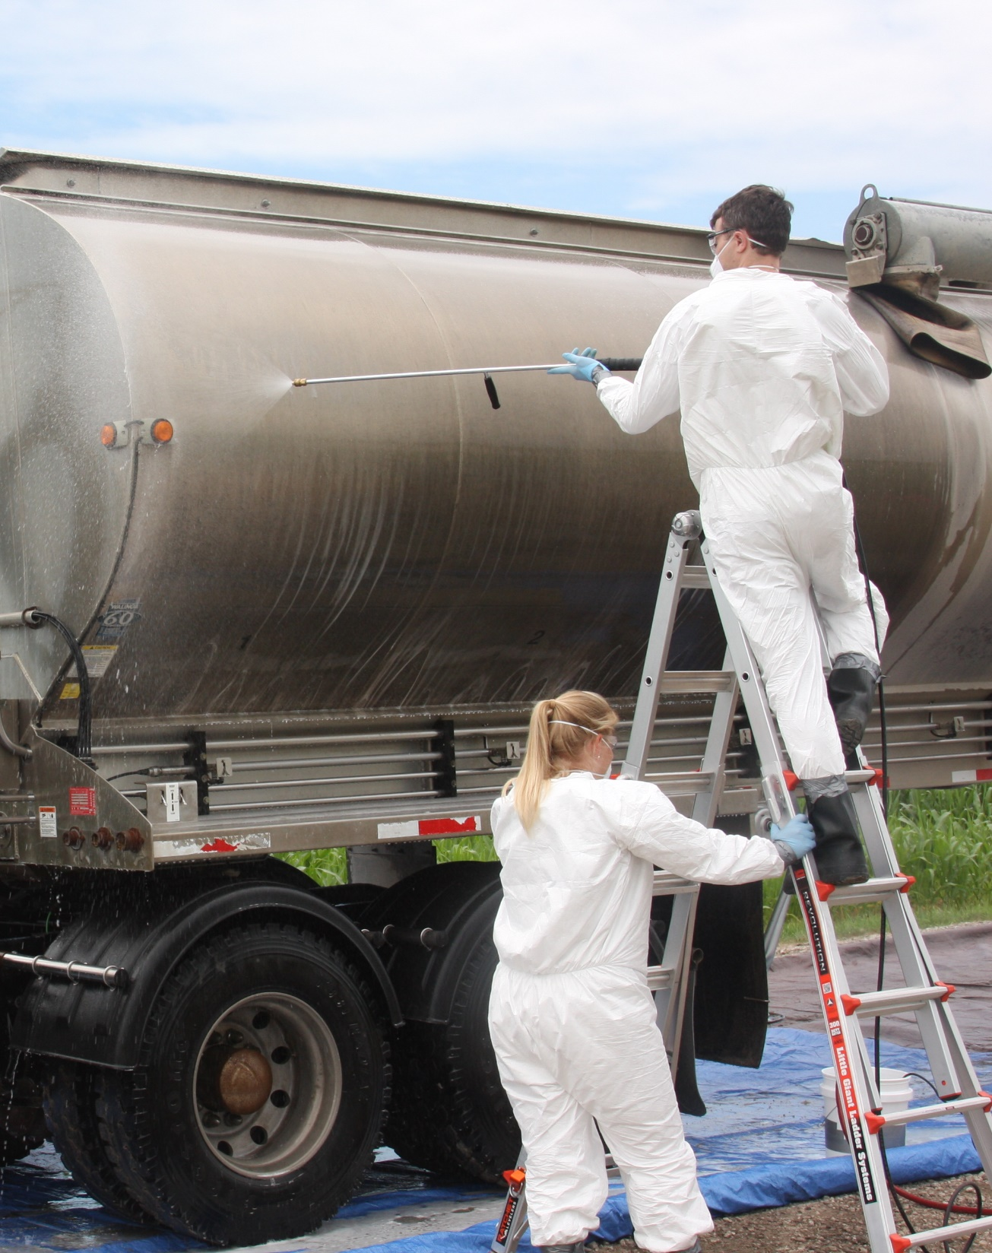
Site Conditions
Uneven or slippery surfaces can lead to slips, trips or falls
Dark conditions reduce visibility
Notes:
Uneven or slippery ground surfaces will occur and make response efforts difficult. Rain, mud, and snow can also contribute to unsafe walking surfaces. Slips, trips and falls can be common. The dark interiors of barns or response activities occurring at night can limit visual abilities.
Photo from Andrew Kingsbury/CFSPH

Slide 18
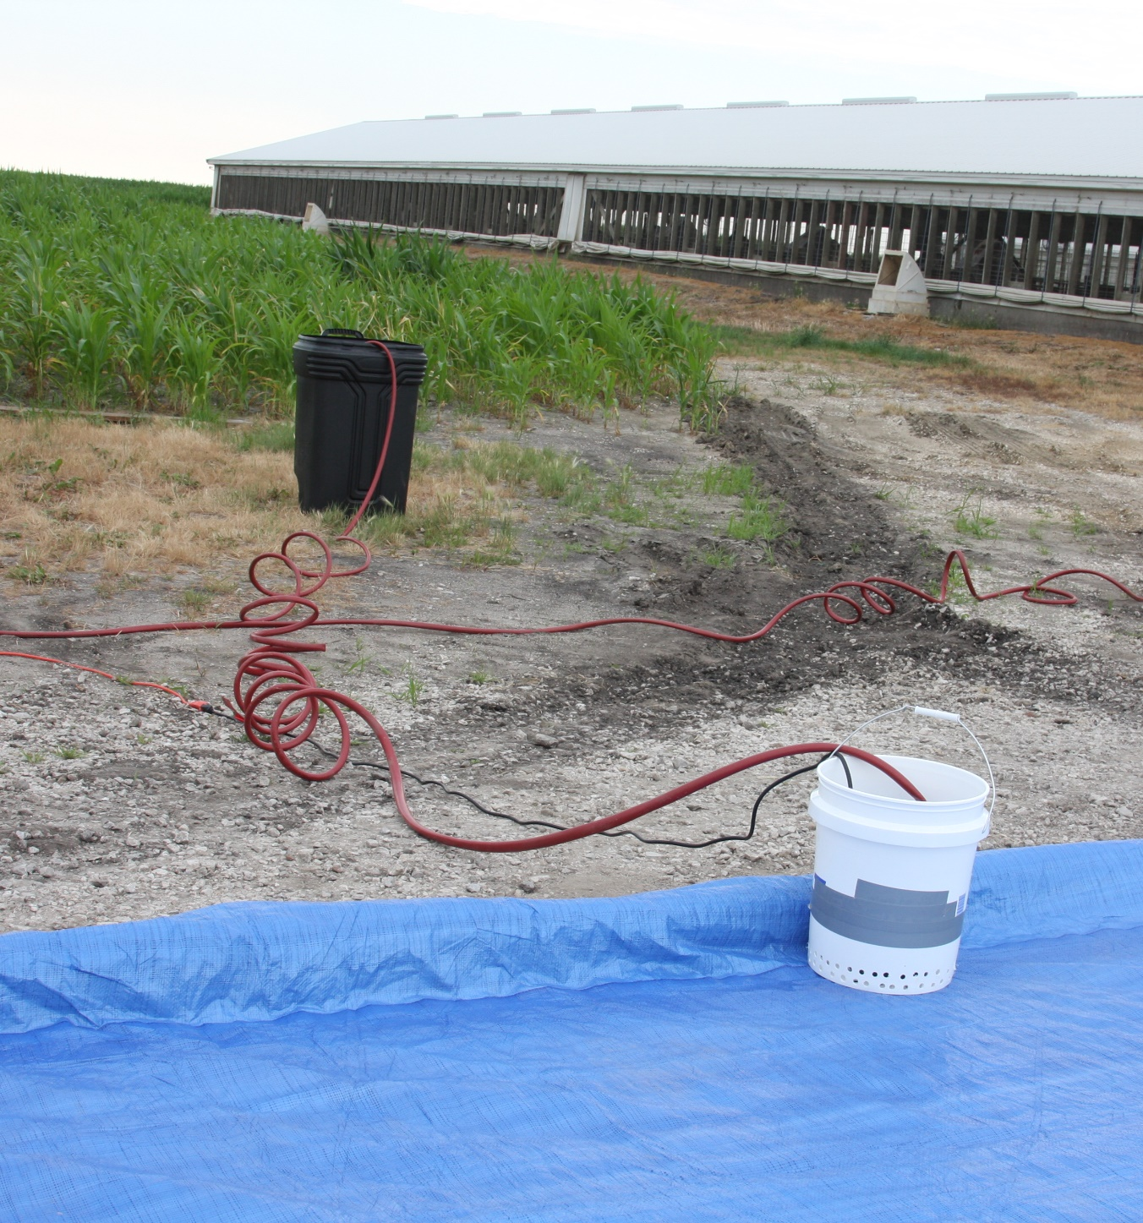
Precautions for Environment Hazards
Train on PPE use
Remain alert!
Adequate lighting
Mark hazardous areas
Notes:
To protect yourself and others, have appropriate training on proper PPE use before any response activity. Remain alert, and watch for hoses, cables, ropes and slippery situations. Ensure you have adequate lighting for any tasks you will be performing and mark hazardous areas to warn others of safety risks.
Photo from Andrew Kingsbury/CFSPH

Slide 19
Heat-Related Illnesses
Heat Cramps
Heat Stress
Heat Exhaustion
Heat Stroke
Life threatening medical emergency
Notes:
Temperature extremes can also increase the risk for certain health and medical conditions. PPE suits and gloves limit or prevent the evaporation of sweat which can lead to overheating. When combined with elevated temperatures, humidity, and working in direct sunlight, it can quickly lead to heat-related illnesses such as heat cramps, heat stress, heat exhaustion, or possibly heat stroke – a life-threatening medical emergency – when proper precautions are not taken.

Slide 20
Precautions for Heat
Fluids and electrolytes
Frequent rest breaks
Tasks in cooler parts of day
Wear cooling devices
Notes:
To avoid heat-related illnesses, drink plenty of fluids and replace electrolytes. Take frequent rest breaks. When possible, conduct tasks during cooler times of the day, and wear clothing, such as cooling jackets or vests, or use field showers or hoses to reduce your body temperature.

Slide 21
Cold-Related Illnesses
Frostbite
Hypothermia
Life threatening medical emergency
Notes:
At the opposite extreme, extended exposure to cold, windy, and wet conditions without adequate clothing can lead to frostbite or hypothermia – another life-threatening medical emergency.

Slide 22
Precautions for Cold
Keep hands, head, face, neck covered
Dress in layers
Avoid overexertion
Stay as dry as possible
Notes:
Prevent cold-related illnesses by keeping your hands, head, face, and neck covered to prevent heat loss. Dress in layers of loose-fitting, lightweight clothing. Avoid overexertion since perspiration can lead to damp clothing. Stay as dry as possible.

Slide 23
Stay Aware and Monitor
Yourself and team members
Follow safety and resting guidelines
Know emergency procedures
Notes:
In conclusion, stay aware and monitor yourself and your team members for signs of injury, fatigue, and heat- and cold-related illnesses. Know and follow established guidelines, including rest periods, for the response. Learn the communication plan and procedures for medical emergencies on site.
Photo from John Wenzel/New Mexico State University

Slide 24
Additional PPE Videos
Notes:
For more information on safety while wearing PPE, including symptoms and first aid for temperature-related illnesses, follow this QR code to the Just in Time Training website.

Slide 25
Acknowledgements
Development of this material was made possible through a grant provided to the Center for Food Security and Public Health at Iowa State University, College of Veterinary Medicine from the U.S. Department of Agriculture (USDA) Animal and Plant Health Inspection Service through the National Animal Disease Preparedness and Response Program (NADPRP)
Notes:
Development of this material was made possible through a grant provided to the Center for Food Security and Public Health at Iowa State University, College of Veterinary Medicine from the U.S. Department of Agriculture Animal and Plant Health Inspection Service through the National Animal Disease Preparedness and Response Program.

