Slide 1
Vaccine Cold Chain Management
Notes:
Vaccination is a response measure that may be implemented in an animal health emergency. Most vaccines must be kept cold or frozen prior to administration in order to be effective. The cold chain must be maintained from manufacturing to administration. Manufacturers, distributors, and animal health personnel all play a role.

Slide 2
Just in Time Training
Notes:
This Just In Time training module will explain how to keep vaccines at the proper temperature at all points in the supply chain so the cold chain is maintained.

Slide 3
Vaccine Cold Chain
Manufacturing
Distribution
Storage
Administration
Maintaining the proper temperature is essential for vaccine effectiveness
Notes:
The cold chain ensures proper temperature maintenance during vaccine manufacturing, distribution, storage, and administration. Excessive heat or cold can damage a vaccine, reducing its potency (strength) and, in some cases, rendering it completely ineffective. Light can also damage some vaccines.

Slide 4
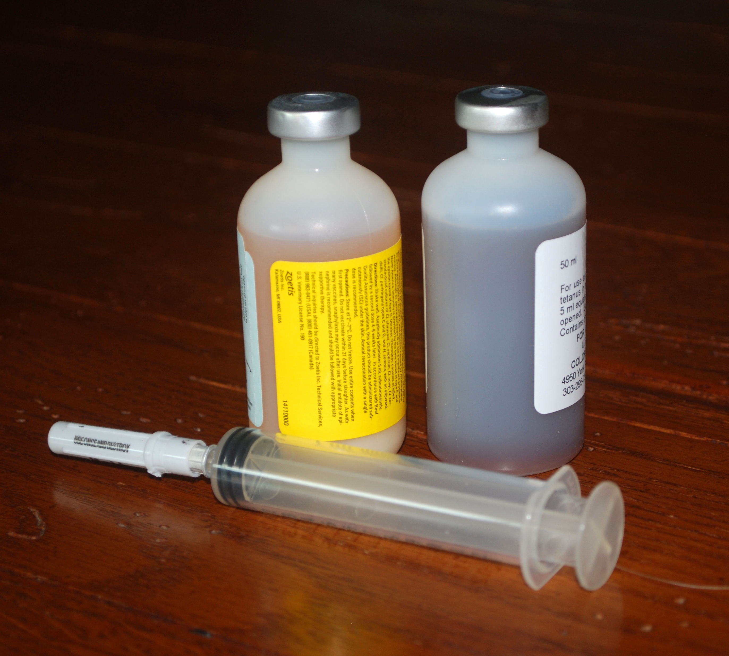
Cold Chain Disruptions
It is impossible to know if a vaccine has been damaged or stored improperly by looking at it
Notes:
Disruptions can occur at any point in the cold chain. Most vaccines will not have detectable changes to their appearance. It is impossible to know if a vaccine has been damaged or stored improperly just by looking.
Photo from Pam Zaabel/CFSPH

Slide 5
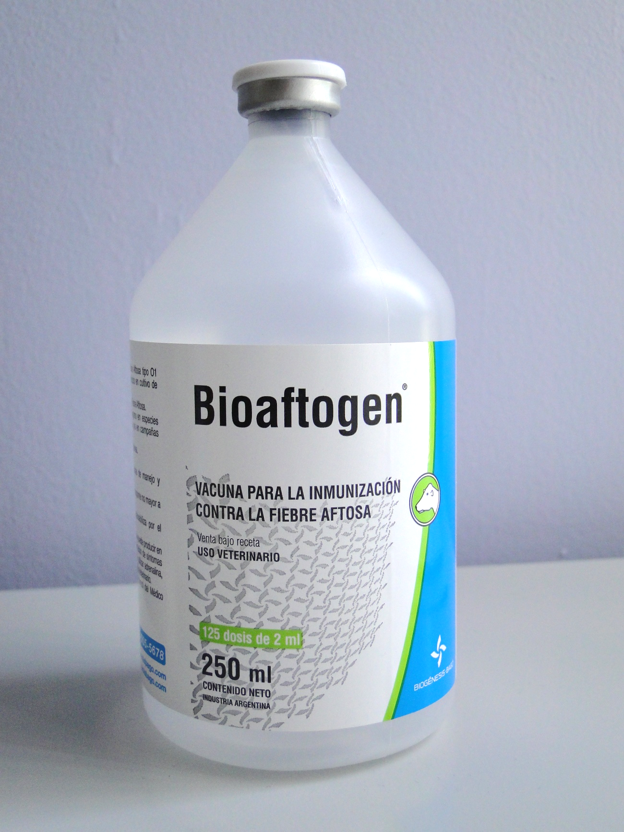
Always Read the Product Label
Example:
Shelf life at least 24 months
Store between 35-46°F
Do not freeze
Keep away from light
Notes:
Not all vaccines have the same temperature requirements. Always refer to the manufacturer’s recommendations for specific vaccine handling procedures. This example shows the shelf life and storage requirements for an inactivated foot and mouth disease (FMD) vaccine.
Photo from Danelle Bickett-Weddle, CFSPH

Slide 6
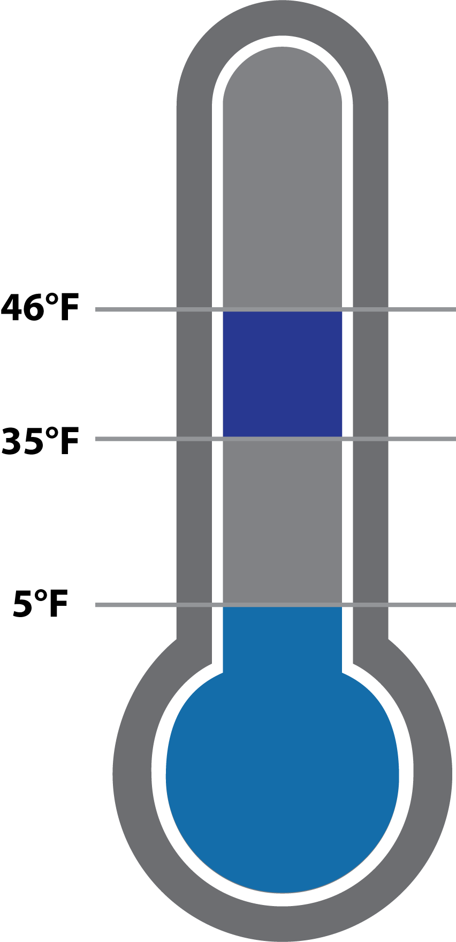
Vaccine Storage
Household or commercial refrigerator
Refrigerated vaccines
Store at 35 to 46°F
Frozen vaccines
Store at 5°F or lower
Diluents
Store with corresponding vaccine
Refrigerated
Frozen
Notes:
At the vaccine distribution site, animal health personnel are responsible for maintaining the cold chain.
Refrigerated vaccines must be stored at 35 to 46°F in a household or commercial refrigerator. Refrigerated vaccines should never be frozen.
Frozen vaccines must be stored at 5°F or lower in a household or commercial freezer.
Diluents (used to reconstitute dried vaccines) do not always require refrigeration. However, they should be stored in the vaccine storage unit with their corresponding vaccine.
Graphic by CFSPH

Slide 7
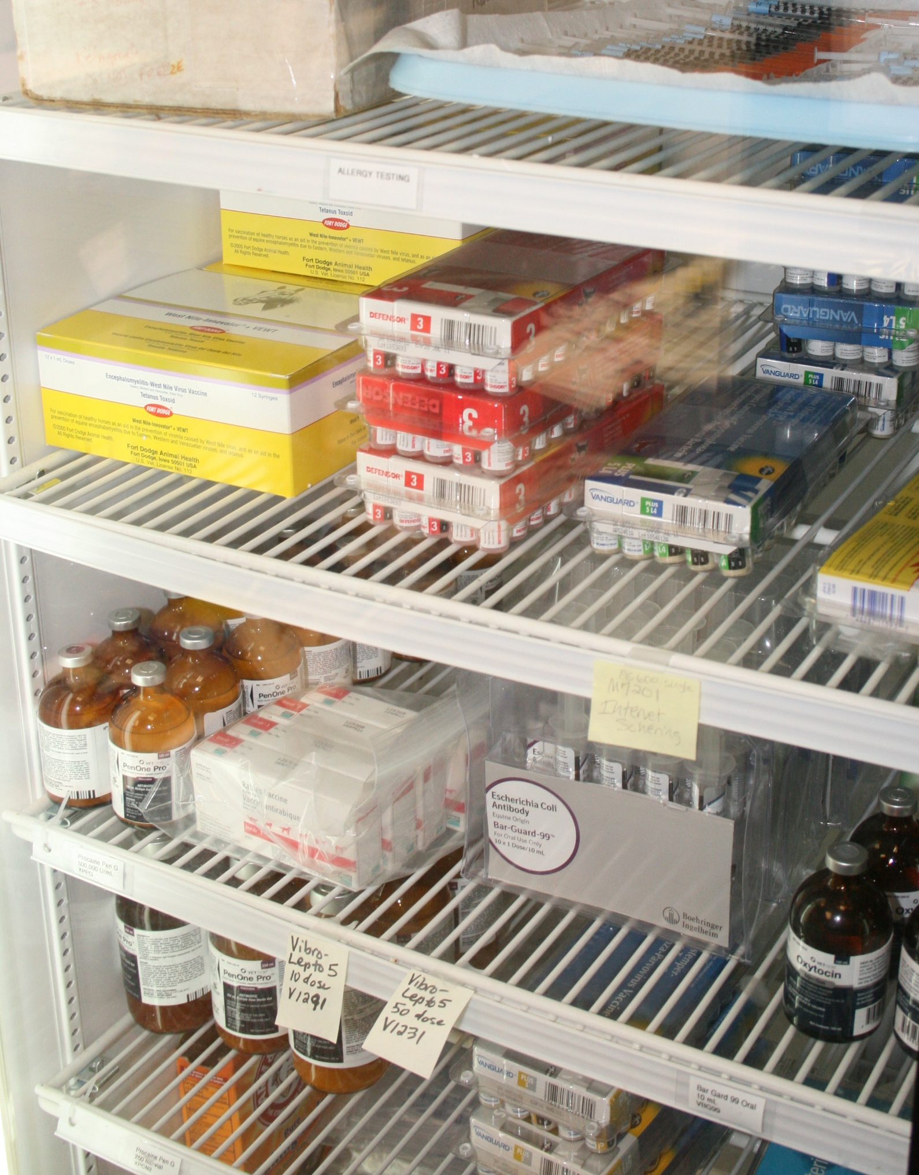
Vaccine Storage Best Practices
Main refrigerator or freezer compartment
Arrange in rows with space between them
Keep earliest expiration dates in front
Notes:
Vaccines must be stored in the main compartment of refrigerators or freezers. Arrange vaccines and diluents in rows with space between them so cold air can circulate. Keep vaccines and diluents with the earliest expiration dates in front so they are used first.
Photo from Andrew Kingsbury/CFSPH

Slide 8
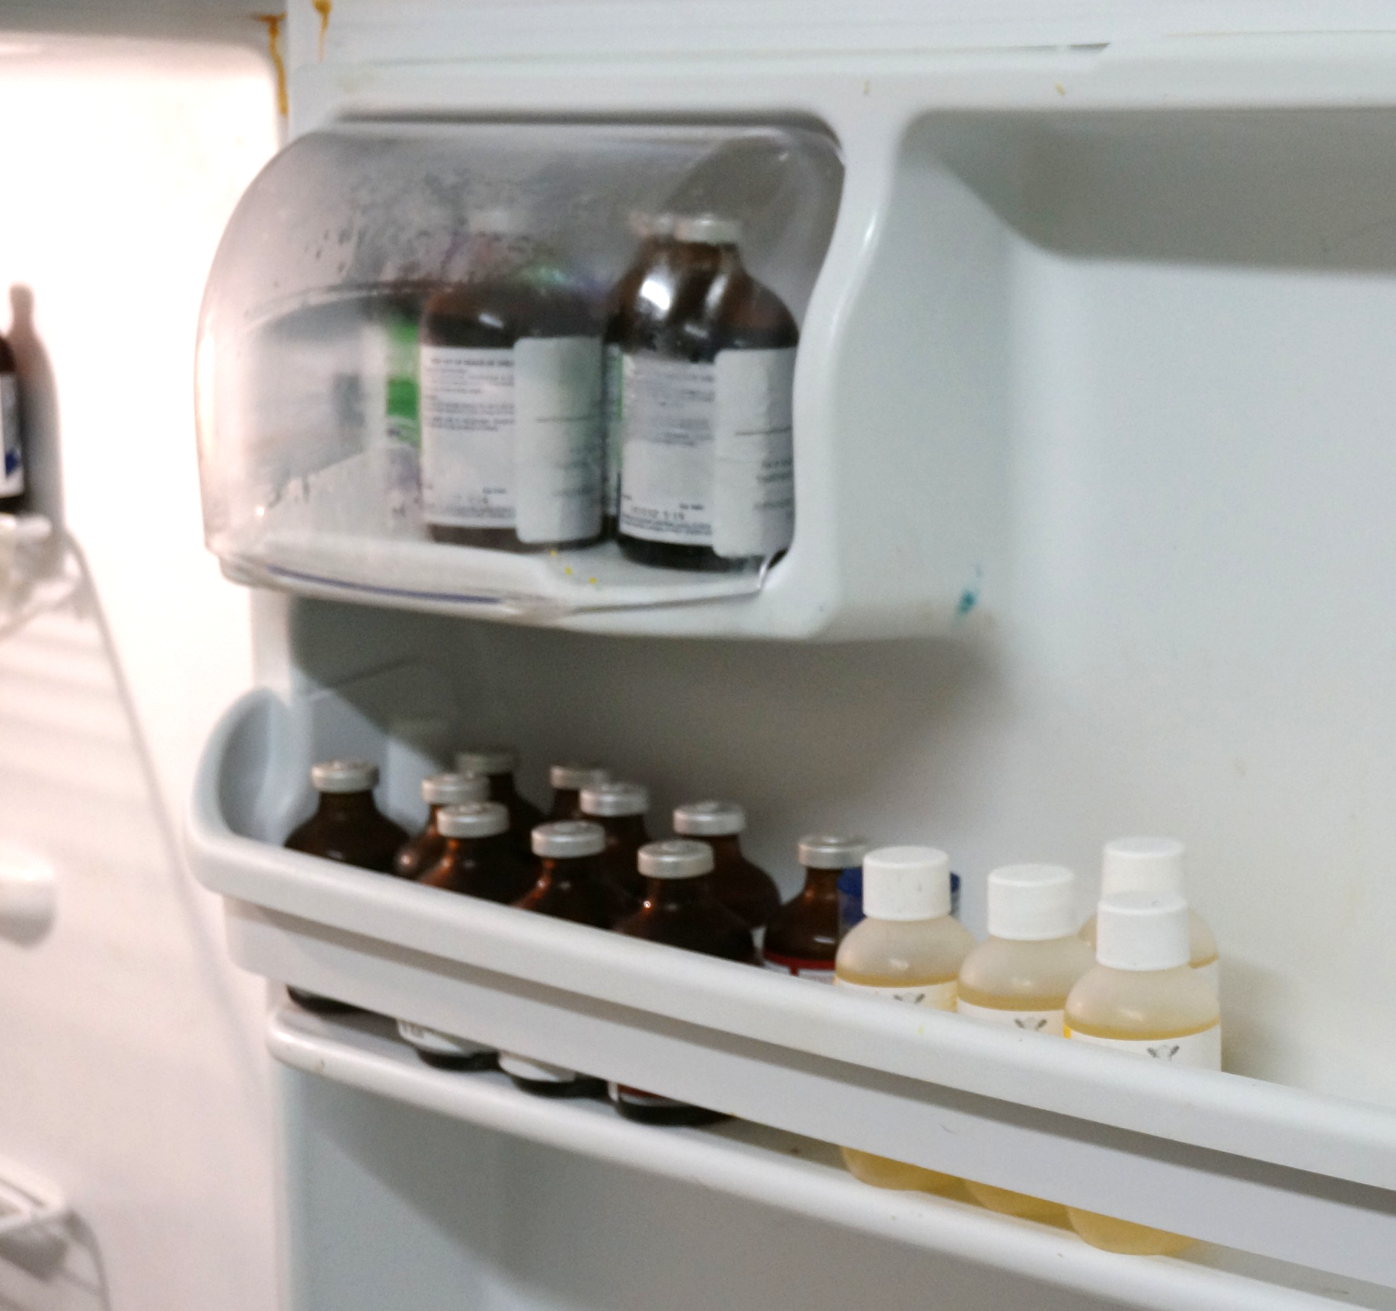
Storing Vaccine
Not on doors, in vegetable bins, or on top shelf
Not in small, dorm-style units long term
Not with dry ice, even temporarily
Notes:
Do not store vaccines in refrigerator/freezer doors, vegetable bins, or on the top shelf. Small, dormitory-style units should not be used for long-term vaccine storage. Dry ice should not be used for vaccine storage, even temporarily.
Photo from Danelle Bickett-Weddle, CFSPH (right)

Slide 9
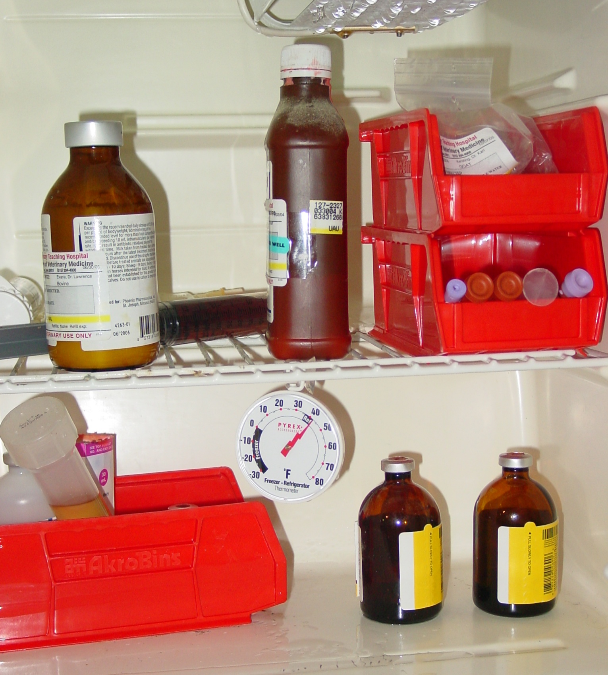
Temperature Monitoring
Monitor temperature at beginning and end of each workday
Use an internal calibrated thermometer, if available
Record temperature, date, time, and name of person who checked the temperature
Notes:
Newly installed or repaired refrigerators and freezers require time to reach temperatures required for vaccine storage. Once in use, the temperature of refrigerators and freezers should be monitored twice daily using an internal calibrated thermometer, ideally at the start and end of the workday. The date, time, and name of the person who checked/recorded the temperature should also be recorded.
Photo: Danelle Bickett-Weddle, CFSPH

Slide 10
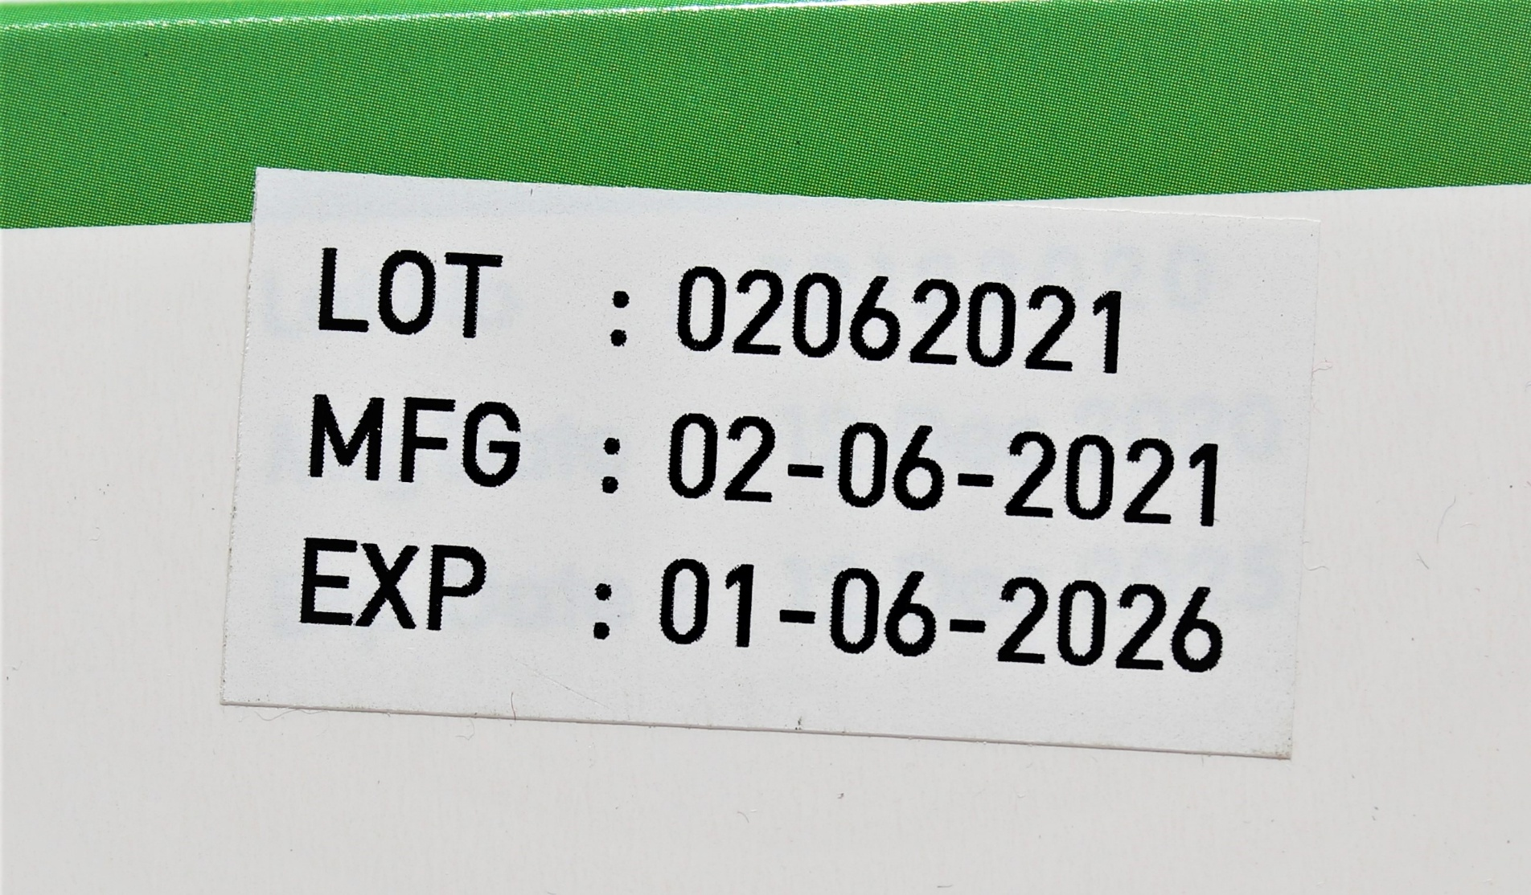
Expiration Date Monitoring
Notes:
All vaccine products are labeled with an expiration date by the manufacturer. Vaccines past the expiration date should never be used. If an expiration date contains only a month and year, the vaccine may be used up to and including the last day of that month. If the expiration date contains a day, month, and year, it may not be used past the end of the indicated day. Vaccines in storage units should be rotated and checked for expired doses regularly.
Photo: Shutterstock

Slide 11
Transport and Packing
Outer container: hard, insulated/Styrofoam
Coolant: gel packs/frozen water bottles
Insulating materials: bubble wrap, packing foam, or Styrofoam
Notes:
Portable refrigerator or freezer units are preferred for vaccine transport, but if unavailable in an emergency, products can be packed using qualified containers, coolants, and insulating materials. Examples include the following:
Containers should include the original shipping box from the manufacturer, and a Styrofoam or hard-sided insulated cooler
Coolants, such as gel packs or frozen water bottles
Cushioning insulating materials, such as bubble wrap, packing foam, or Styrofoam to place above and below the vaccine, and cardboard cut to fit the interior dimension of the cooler

Slide 12
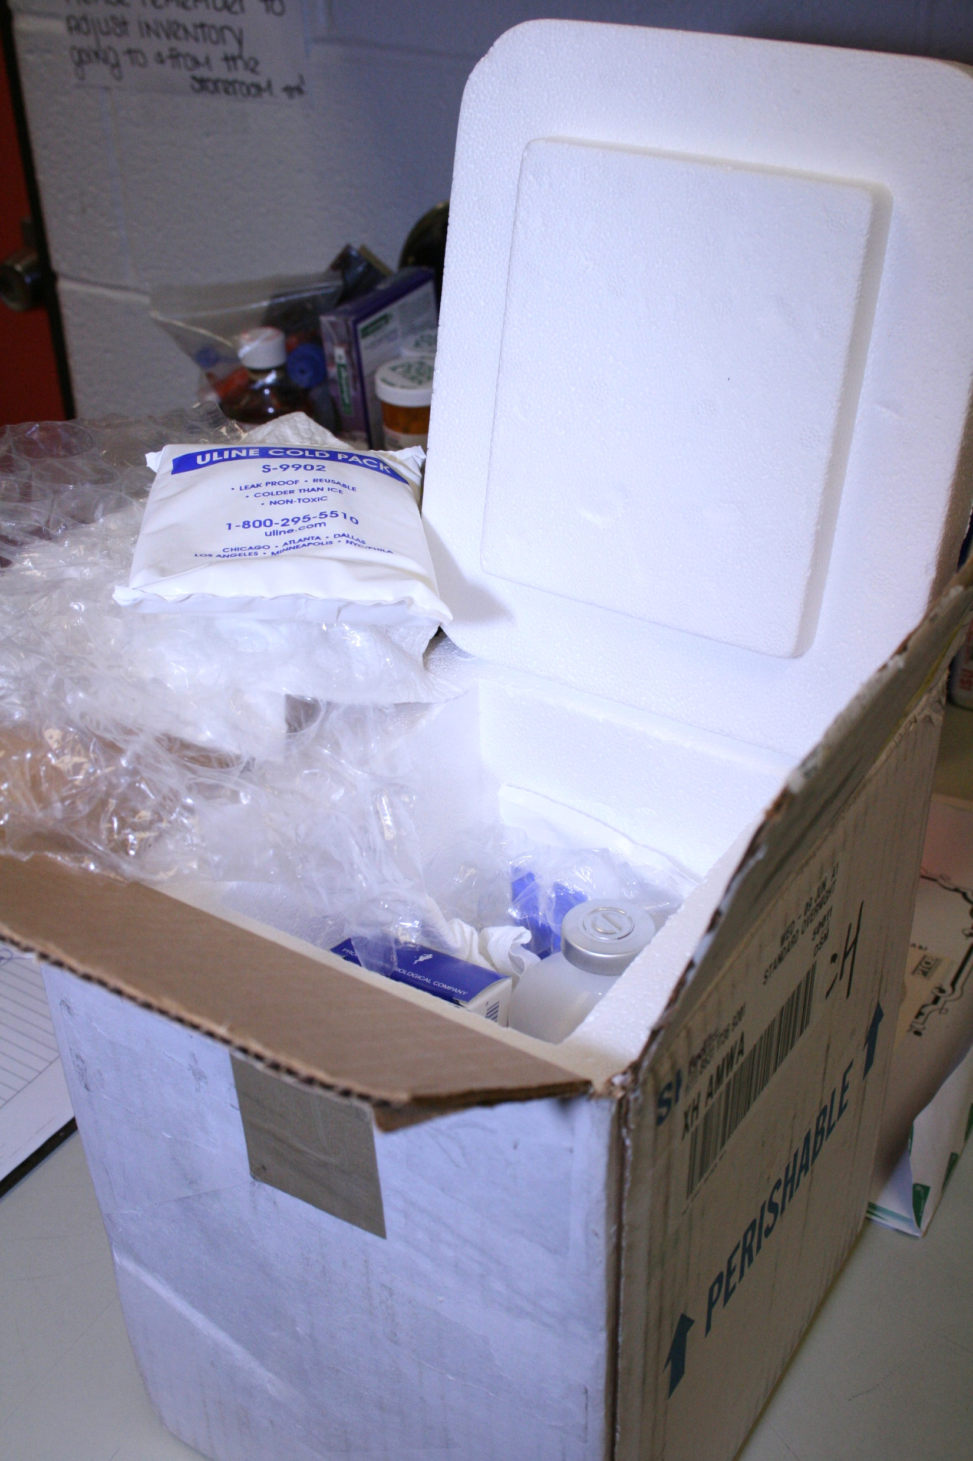
Packing Best Practices
Do not use soft-sided, collapsible coolers
Do not re-use frozen gel packs or coolant packs from the original vaccine shipment
Do not use loose or bagged ice for cooling
Do not transport opened vials
Notes:
Follow these best practices to keep vaccines at the proper temperature during transport.
Do not use soft-sided, collapsible coolers
Do not re-use frozen gel packs or coolant packs from the original vaccine shipment
Do not use loose or bagged ice for cooling
Do not transport opened, partially used vials
Photo: Andrew Kingsbury, CFSPH

Slide 13
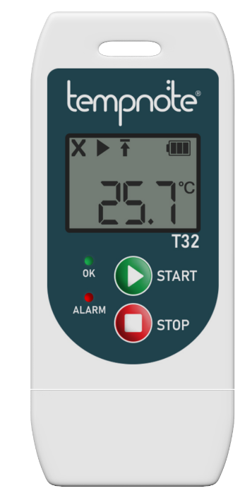
Transport Monitoring: Digital Thermometer
Digital data logger
Buffered probe
Placed inside transport package
Records temperature minimum and maximum
Notes:
During vaccine transport, a temperature monitoring device should be used to record minimum/maximum temperatures. A digital data logger with a buffered probe is ideal. Temperature monitoring is especially important for frozen vaccines.
Photo: Pulkit Patel, Wikimedia Commons, CC BY-SA-4.0

Slide 14
Transport Monitoring: Cold Chain Monitors
Heat Indicator
Freeze Indicator
For single use
Indicates if a certain temperature has been exceeded and for how long
Needs preconditioning
For single use
Indicates if temperature drops below 32°F
Does not indicate length of time that package contents were frozen
Notes:
Cold chain monitors can be included in the package to indicate whether vaccines have been exposed to improper temperatures during transport. Heat indicators are made for a single use not exceeding 48 hours. They indicate if temperatures have exceeded a certain temperature (for example, 50°F) and for how long. Heat indicators should be pre-conditioned by placing them with the vaccines until their temperature reaches equilibrium with the vaccine. Freeze indicators are also for a single use. They do not indicate the length of time exposed to freezing temperatures, only that the contents of a shipment have dropped below 32°F.

Slide 15
Vaccine Unpacking
Check cold chain monitor
Contact USDA officials if a temperature failure occurred
Label vaccines DO NOT USE, store at appropriate temperature, wait for guidance
DO NOT immediately discard vaccines; they may be in short supply
Notes:
You cannot tell if a vaccine has been damaged by looking. When unpacking vaccines, first check the cold chain monitor. If there has been a temperature reading outside of the recommended range during transport, contact USDA officials before using the vaccine. Label the vaccine DO NOT USE and store at appropriate temperatures until further guidance is received. DO NOT DISCARD VACCINES immediately, as vaccines may be in short supply in the event of an outbreak.

Slide 16
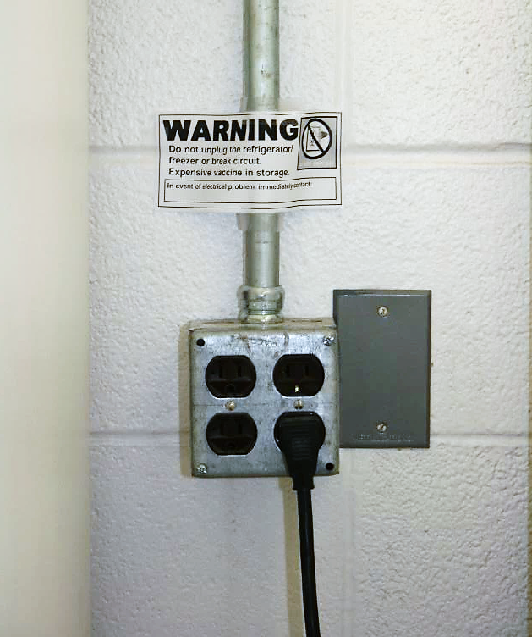
Contingency Planning
Power supply
Do not use outlets that are switched or can be tripped
Use properly sized generator if other power sources not available
Personal safety
Needlesticks can lead to illness, infection, or tissue damage
Seek medical attention if needed
Notes:
Power disruptions can destroy an entire vaccine supply. Plan to protect the vaccine storage unit’s power supply. Do not power a vaccine storage unit using outlets that can be tripped or switched off. A properly sized generator may be used to power a vaccine storage unit in an emergency. Some vaccines can cause serious illness or infection in humans if they are accidentally injected or stuck with a needle. Use caution when handling vaccines in an animal health emergency. Many killed vaccines for use in animals have potent adjuvants that may cause severe tissue reactivity in humans, especially if injected into a joint such as a finger joint. Always seek attention from a physician if vaccine exposure is suspected.
Photo: Andrew Kingsbury, CFSPH

Slide 17
Key Points
Manufacturers, distributors, and animal health personnel all play a role in maintaining the vaccine cold chain
Always check the vaccine label to determine temperature requirements
If a temperature failure occurs, consult animal health officials before discarding vaccines
Notes:
Manufacturers, distributors, and animal health personnel all play a role in maintaining the vaccine cold chain. Always check the vaccine label to determine temperature requirements. If a temperature failure occurs, consult animal health officials before discarding vaccines.

Slide 18
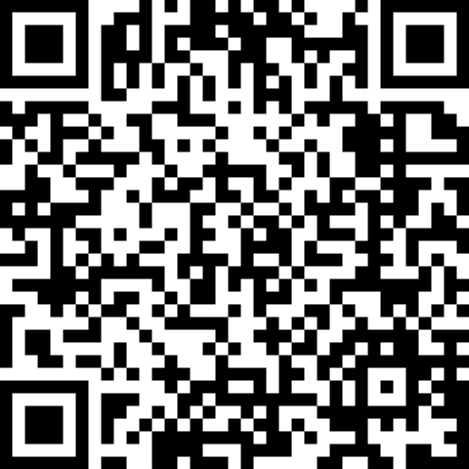
For More Information
Notes:
For more information on vaccination, follow this QR code to the Just in Time Training website.

Slide 19
Acknowledgements
Development of this material was made possible through a grant provided to the Center for Food Security and Public Health at Iowa State University, College of Veterinary Medicine from the U.S. Department of Agriculture (USDA) Animal and Plant Health Inspection Service through the National Animal Disease Preparedness and Response Program (NADPRP)
Notes:
Development of this material was made possible through a grant provided to the Center for Food Security and Public Health at Iowa State University, College of Veterinary Medicine from the U.S. Department of Agriculture Animal and Plant Health Inspection Service through the National Animal Disease Preparedness and Response Program.

